Slide 1
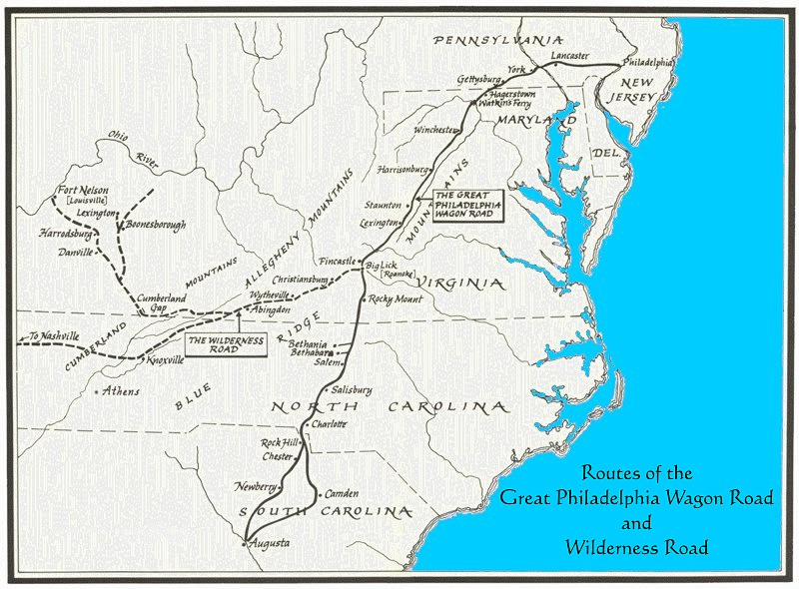
Daily Quiz- 9/11
1. The Wilderness Road, shown on the map
is most closely associated with
A. Daniel Boone
B. Dragging Canoe
C. James Robertson
D. Thomas Sharpe Spencer
2. Who is known as the “Father of Middle Tennessee”?
Daniel Boone
William Bean
James Robertson
Thomas Sharpe Spencer

Slide 2
Rising Tensions

Slide 3
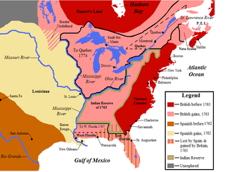
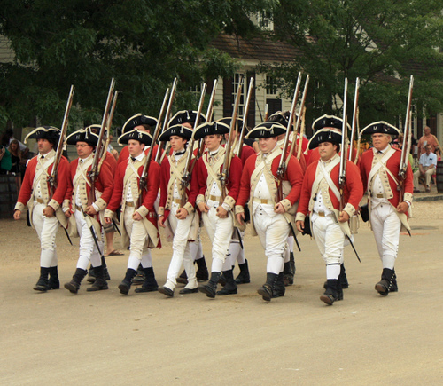
Ending Salutary Neglect
Britain becomes more involved in the Colonies
Mercantilism: Britain takes advantage of colonies
War debt: Need money to pay for French and Indian war in the colonies
Maintaining colonies: Britain stations soldiers in the colonies and must pay them
Mother Country
provides security and manufactured goods
Colonies
provide raw materials and a consumer market

Slide 4
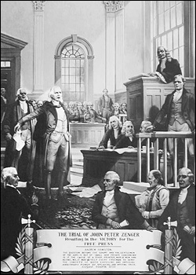
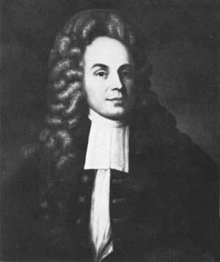
John Peter Zenger Trial
A newspaper editor, John Peter Zenger printed critical views of the royal governor of New York
He was charged with the crime of lying about a royal official
He was found innocent
Established the principle of Freedom of the Press in the colonies

Slide 5
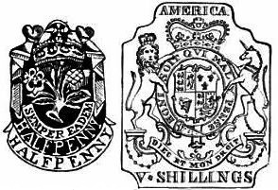
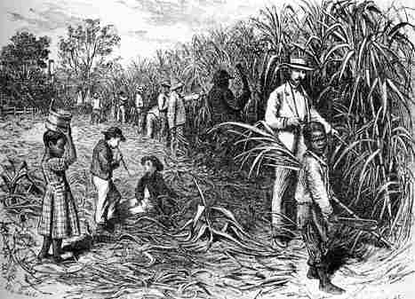
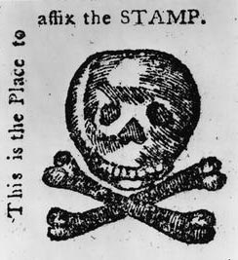
Sugar and Stamp Acts
Sugar Act: tax on sugar (molasses) imported to colonies
first tax on the colonies by Britain
Stamp Act: direct tax on colonists
Required a stamp on all printed materials (legal documents, newspapers, playing cards)

Slide 6
Discussion
Why did Britain end salutary neglect?
How did the John Peter Zenger trial impact relations between Britain and the colonies?
What response would you expect the colonists to have about the Sugar and Stamp Acts?

Slide 7
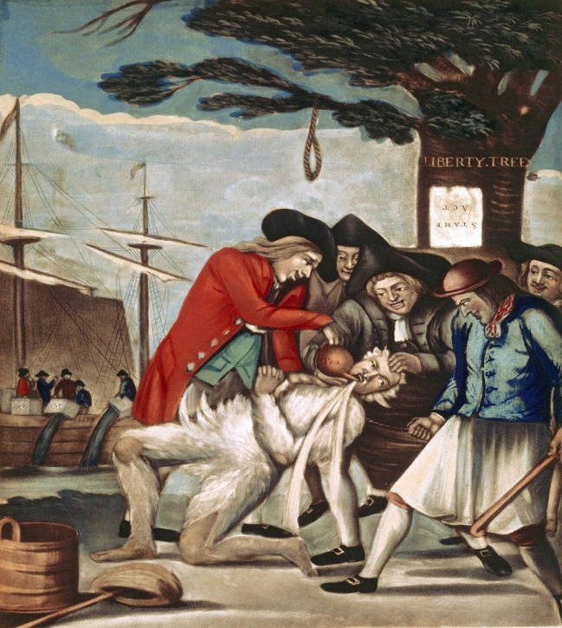
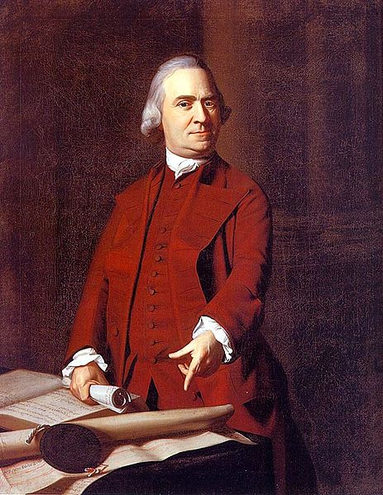
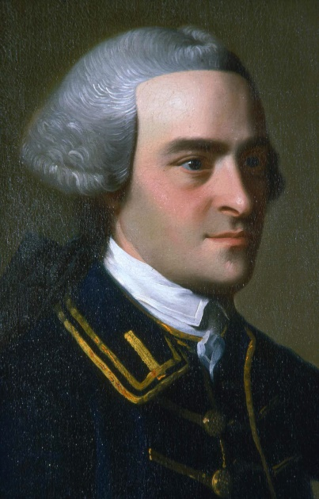
Reaction of Colonists
Colonists very upset by taxes
Felt they were being taxed by a government they had no say in
“No taxation without Representation”
Sons of Liberty formed by Samuel Adams and John Hancock (smuggler and merchant)
Group founded to protest British policies (violently at times)
Set up boycotts (refused to buy) of taxed goods

Slide 8
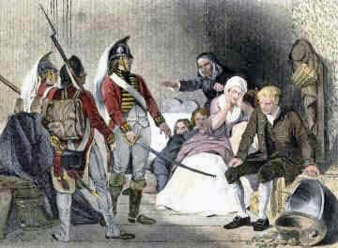
Britain Responds
Quartering Act: required colonists to allow British soldiers to live in their homes and feed them
Britain says it is to protect from Native Americans but really to catch smugglers not paying taxes

Slide 9
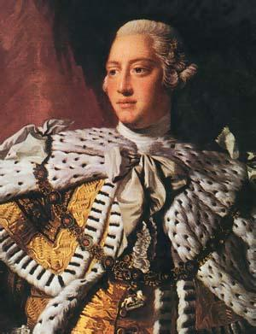
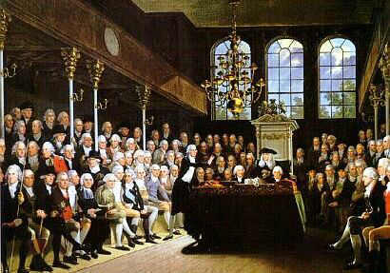
Britain’s Declaration
After the Sons of Liberty boycotts, Britain changes its mind
Repeals (ends) the Sugar and Stamp Acts BUT
Declaratory Act: British Parliament declares it has the authority to govern the colonies by any means (including taxes)

Slide 10
Reflection
Which act/policy do you believe angered the colonists the most? Why?

