Slide 1
Madison’s America

Slide 2
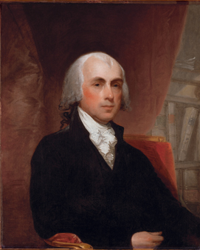
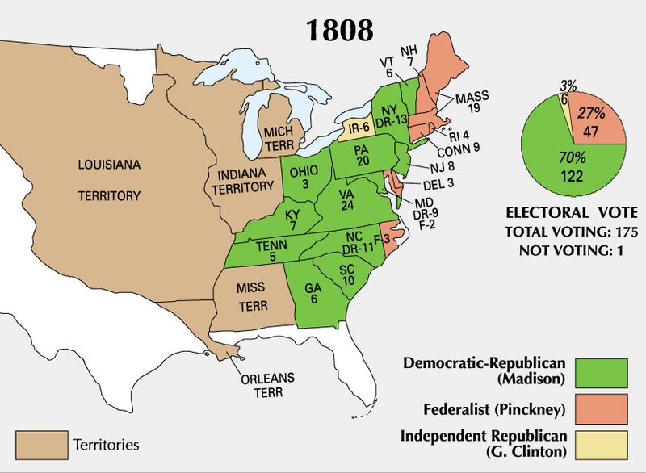
Election of 1808
Federalists hoped that the unpopular Embargo Act would doom the Democratic Republicans
It did not, Jefferson’s Secretary of State James Madison was elected president
Madison rode Jefferson’s success but was left with a lot of issues to deal with

Slide 3
Discussion
How could James Madison, Jefferson’s most trusted friend, taking over the problems of Jefferson be an awkward situation?

Slide 4
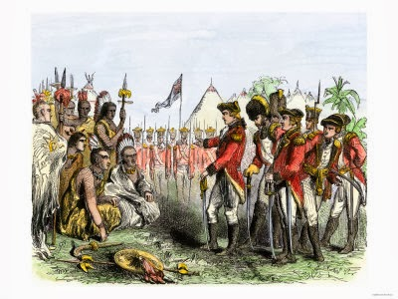
War Looms
Jefferson’s embargo was a failure, Madison adjusts it
Only embargo on Britain (since France had backed off)
More issues with Britain
Problems with Indians on the frontier (British convincing Native Americans in west to attack American settlers)
Impressment (forcing American sailors to serve on British ships) just as much of an issue as before
Americans desire to acquire land in Canada

Slide 5
Discussion
How had the United States previously attempted to solve issues with Britain?

Slide 6
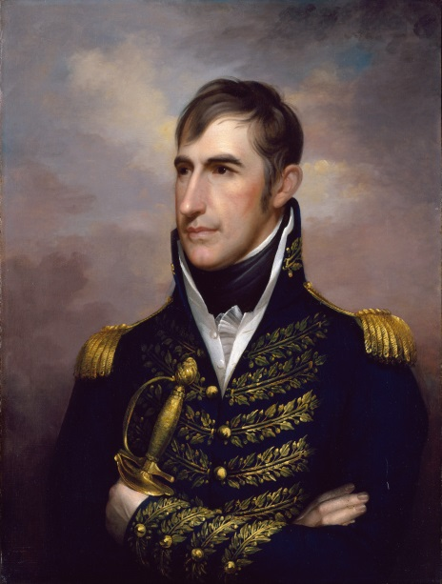
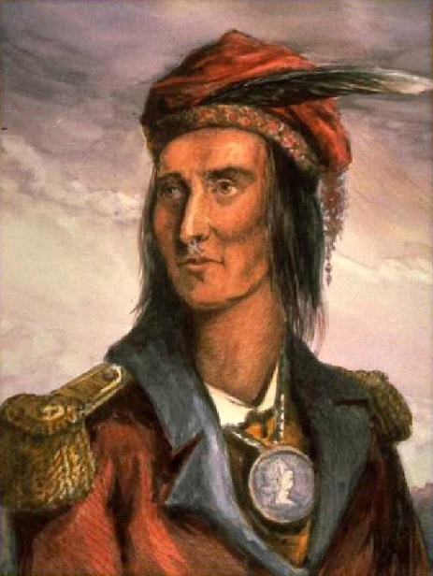
Native American Relations
Native American leader Tecumseh wanted to unite and strengthen tribes
of the Midwest
Goal: Stop expansion of whites westward
Britain was less of a threat
Tecumseh meets with Gov. William Henry Harrison of Indiana
Harrison threatened by Tecumseh’s friendship with Britain
Tecumseh declared if expansion did not stop, there would be war

Slide 7
Discussion
How does Tecumseh pose a different threat to white settlers than other Native American leaders?

Slide 8
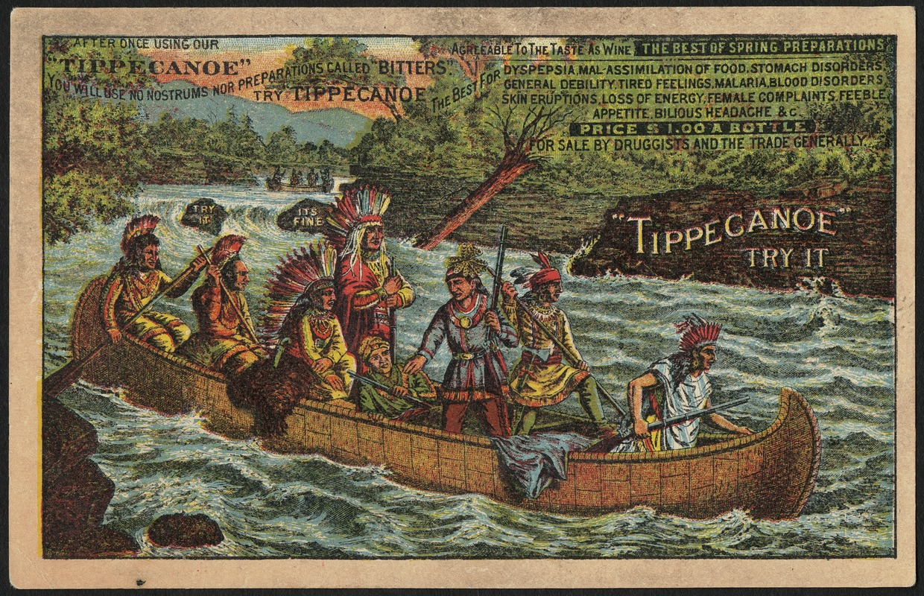
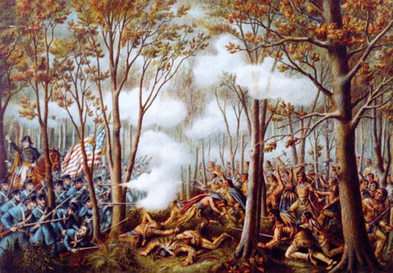
Battle of Tippecanoe
Harrison ambushed the Natives at Tippecanoe and defeated Tecumseh
Effects:
American victory makes Tecumseh join with British
Increased tensions between America and Britain

Slide 9
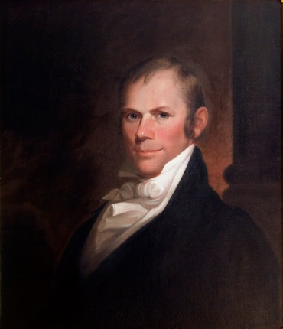
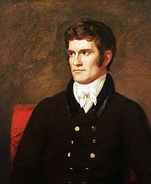
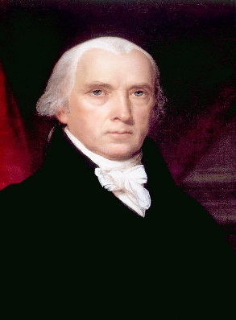
“Mr. Madison’s War”
As tensions grew, Madison determined that war with Britain was inevitable
Strongest support for war came from young Republican members of Congress- the War Hawks
People who support increased military spending and involvement- goal: expand the country
Major war hawks: Henry Clay (West) and John C. Calhoun (South)

Slide 10
Reflection
Who would you believe would have the advantage in a conflict between Britain and the United States?

