Slide 1
Washington’s Presidency

Slide 2
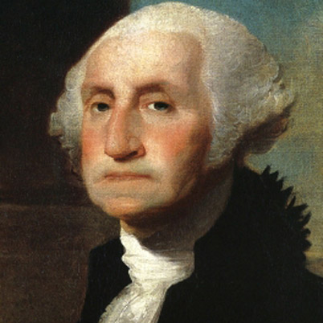
Setting an Example
George Washington was elected as the first President of the United States
Being the first, he had no example to follow.
Washington ends up setting the precedent (examples) for all future Presidents to follow.

Slide 3
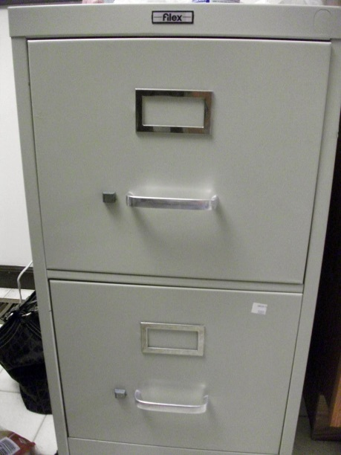
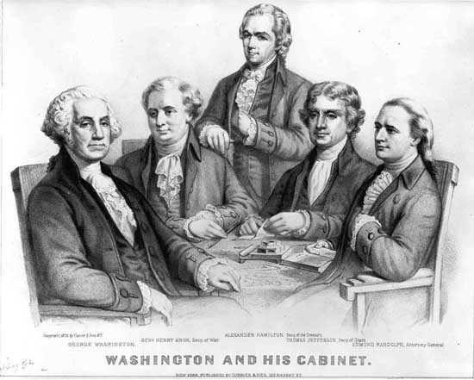
Creating a Cabinet
President was given the ability to select people to help him run the government.
State- deal with foreign countries (Thomas Jefferson)
Treasury- deal with finances of the nation(Alexander Hamilton)
War- deal with defense of the nation (Henry Knox)
Justice deal with legal issues (Edmond Randolph)

Slide 4
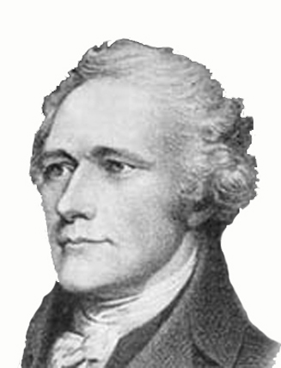
Hamilton’s Plan
Biggest issue: money problems
Hamilton came up with a plan to fix the money troubles
Debt: Many states owed debt from war they couldn’t pay
National debt: government assumed (took over) state debt
In exchange, Southern states get nation’s capitol
Built up American credit= trust from other countries
Use tariffs (taxes on imported goods) to get more money
Create a National Bank to create and manage money

Slide 5
Discussion
What benefits could come from a cabinet? What are some negatives?
What were the 3 things Hamilton addressed in his plan?
What issues do you predict may come up from his plan?

Slide 6
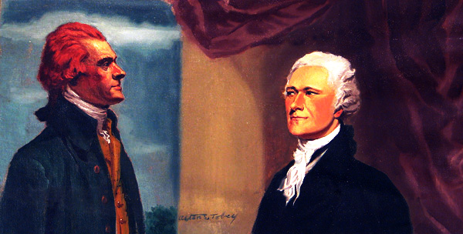
Hamilton’s Opponents
Some (Jefferson, Madison) did not like Hamilton’s plan (especially the bank)
They did not believe the Constitution allowed it.
Washington backed Hamilton’s plan to help the nation.

Slide 7
Different Views of Constitution
Disagreement between Jefferson and Hamilton led to two views of Constitution:
Strict Interpretation: Follow Constitution exactly as its written
Leads to less power to government
Loose Interpretation: Constitution can be stretched to fit situation
Leads to greater power to government

Slide 8
Reflection
Which interpretation do you believe is better for the Constitution? Why?

