Slide 1
Daily Quiz-10/24
1. A person who believes the Constitution should be stretched from time to time for the best interest of the country has a…?
a. Loose Interpretation
b. Strict Interpretation
2. A person who believes the Constitution should be followed exactly as it is written with no exceptions has a…?
a. Loose Interpretation
b. Strict Interpretation

Slide 2
Washington’s Challenges

Slide 3
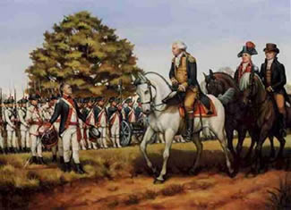
Issues at Home
Backcountry farmers
Very independent and do not want government in their lives
Whiskey used as currency for many
Government (Hamilton) taxed Whiskey
Farmers not too happy at all
Whiskey Rebellion: Farmers rebelled against government because of taxes
Washington used this as a way to show government ability to enforce laws

Slide 4
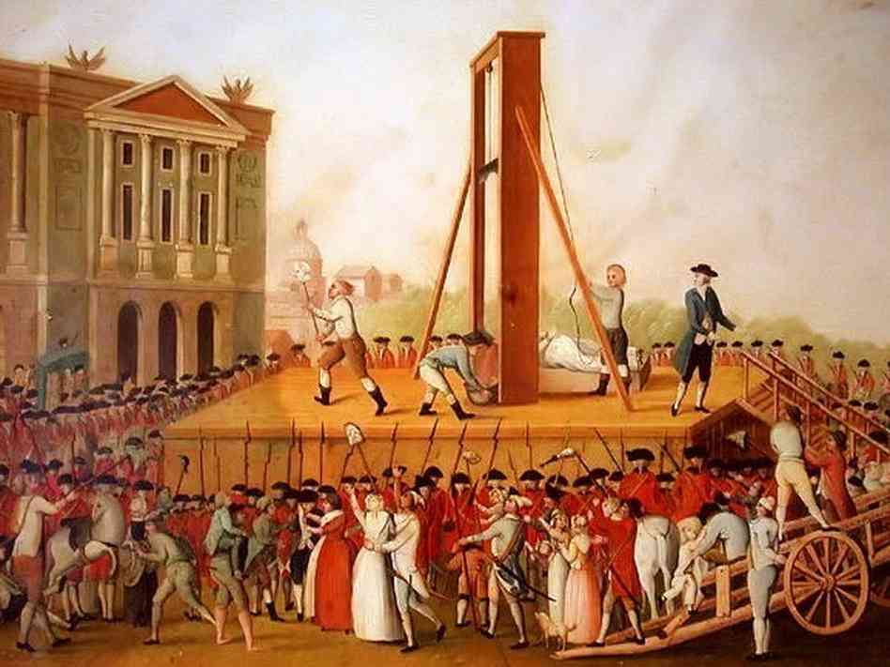
Issues with other countries
France
Going through Revolution… not pretty
Jefferson supports French Revolution and wants US to help them
Washington and Hamilton do not
France declares war on Britain expects US to help
Washington says US will keep neutrality (not getting involved)

Slide 5
Discussion
What were some of the issues at home during Washington’s presidency?
What was going on in France? How would this impact the United States?
How could Washington’s neutrality translate into the United States’ relations with other countries?

Slide 6
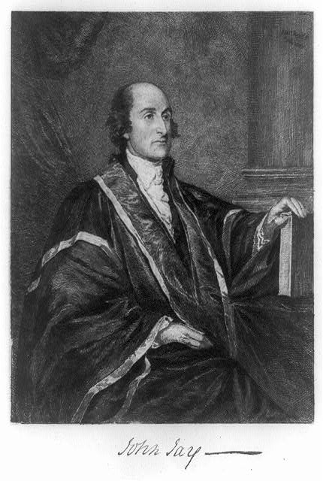
Issues with other countries
Britain
They are still America’s top trade partner
Britain was disrupting American affairs
Still in the west provoking Native American attacks
Hijacking US trade ships and capturing sailors
Jay’s Treaty: treaty with Britain to avoid war
Upsetting to Americans
Did not address all the problems with Britain

Slide 7
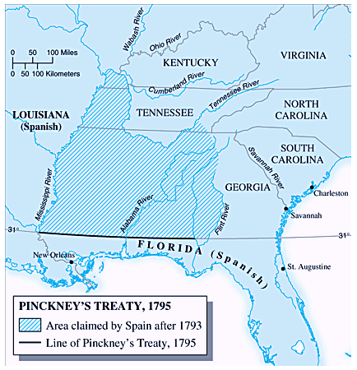
Issues with other countries
Spain
Control land on other side of Mississippi river
Have stopped US from using Mississippi river to transport and trade goods
Both sides want to prevent any problems
Pinckney’s Treaty: Allowed US to use the Mississippi river and New Orleans to trade goods

Slide 8
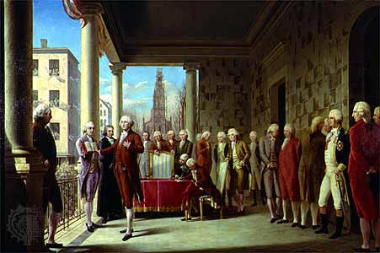
Washington’s Farewell
Washington’s Farewell Address:
Addresses his biggest concerns for the nation’s future
Political Parties= dividing the nation
Foreign Alliances= dangerous

Slide 9
Reflection
Should future American leaders listen to Washington’s concerns in his Farewell Address? Why?

