Slide 1
Daily Quiz 11/28
1. The practice of impressment had to do with
A putting people into prison for debts.
B forcing sailors to serve on British ships.
C blockading the ports of countries at war.
D paying a tax on goods shipped from New Orleans.
2. Which politician made a reputation as a War Hawk?
A Henry Clay
B James Madison
C Andrew Jackson
D John Quincy Adams

Slide 2
Daily Quiz 11/28
3. Tecumseh presented a great threat to American expansion and settlement because he was able to
A use religion to rally people to support the British.
B unite and strengthen the tribes of the Midwest.
C convince Indians to adopt white men’s ways.
D defeat stronger armies with his warriors.

Slide 3
War of 1812

Slide 4
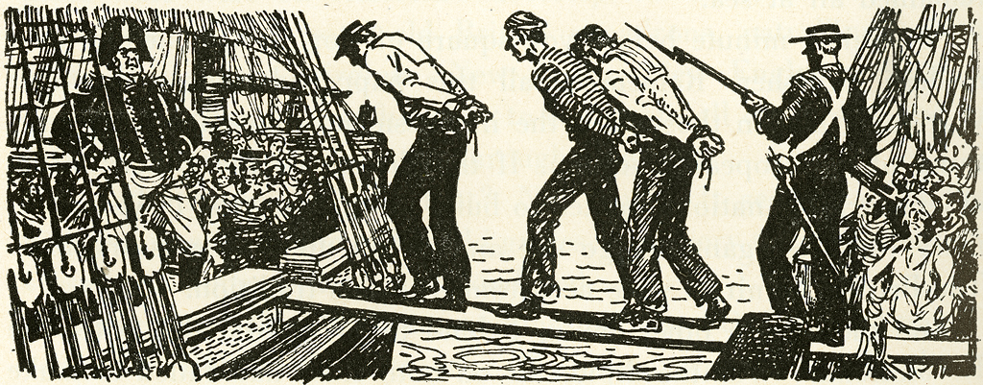
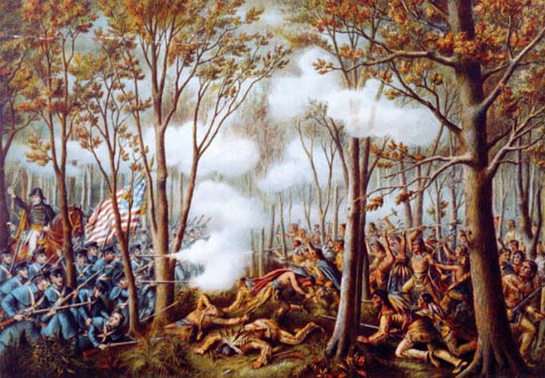
Causes of War
British Impressment of US citizens
Capturing US traders from their ships and forcing them into labor
Native American alliances with Britain
British were influencing Native Americans in the west and Great Lakes, upset Americans
Rise in American Nationalism (war hawks want America to stand up to Britain)
War Hawks pressuring leaders to stop British abuse
Why could a rise in Nationalism lead to war?

Slide 5
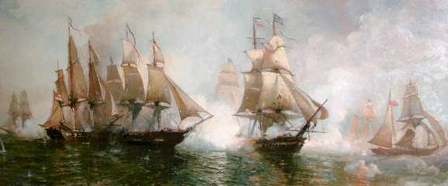
First Phase
Theme: Britain focused on France, not US
British Blockade
Britain started the war by blockading the American coast to cut off trade
Battle in the Great Lakes
Battle of Lake Erie: America was able to push the British back into Canada
Battle of the Thames: W.H. Harrison chased Britain into Canada and ended the threat to the Northwest
Why might the British blockade not impact America as much as the British want?

Slide 6
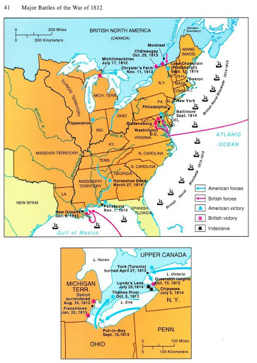

Slide 7
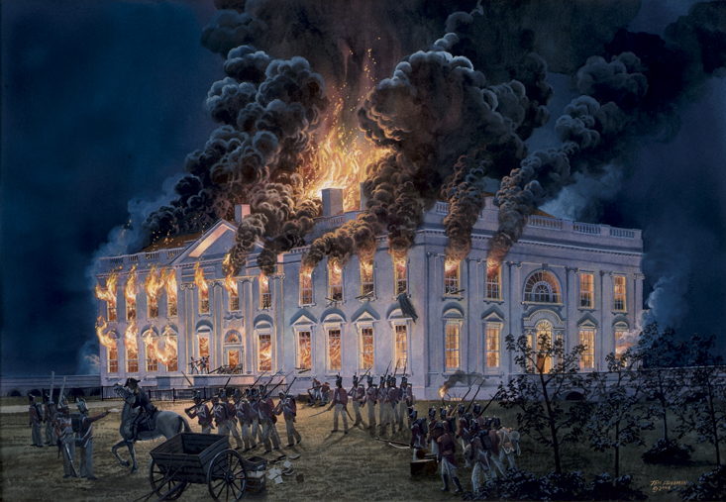
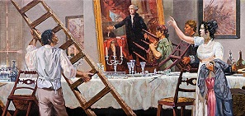
Second Phase
Theme: Britain defeats France and puts focus on America (uh oh)
Burning of Washington DC: Britain stormed the capital and burned the city to the ground
Battle of Fort McHenry: America fought off British attempts to take the important Fort McHenry (inspired the Star Spangled Banner)
Britain lost in an attempt to force their way in from Canada
Based on the two phases, who do you predict should win this war?

Slide 8
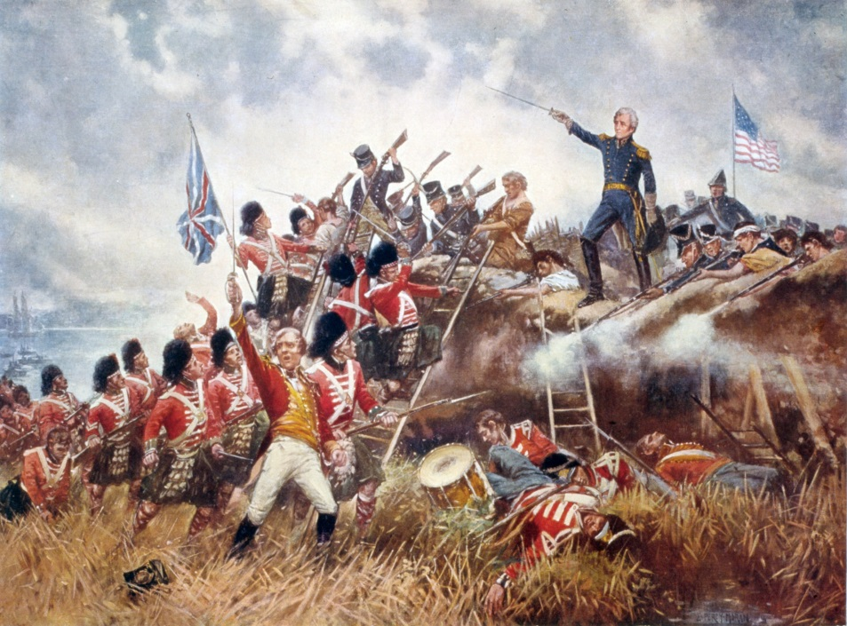
Ending the War
Britain realized, this war was too costly
They agreed to the Treaty of Ghent
Ended the War
Not everyone got the news
Battle of New Orleans: American general Andrew Jackson leads America to a huge victory…even though the war was already over

Slide 9
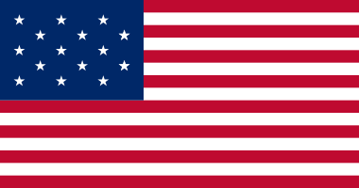
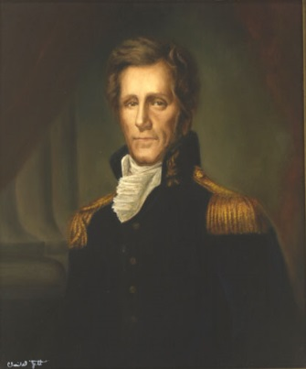
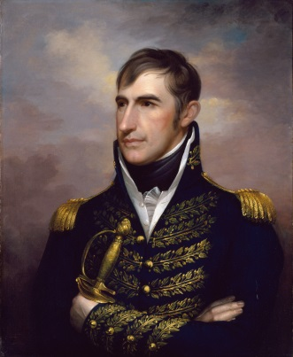
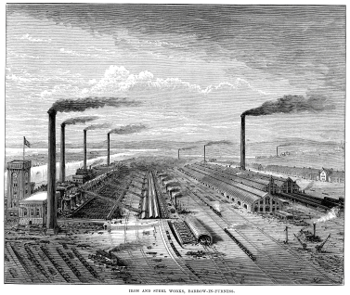
Effects of the War
Birth of American Heroes
Generals rise up as heroes from the war
Jackson and Harrison
Native American resistance defeated
Native Americans had been defeated with British
Growth of US industry
Because of blockade, US had to produce everything for itself
Rise in Nationalism

Slide 10
Reflection
Which effect of the war do you believe was the most significant?

