Slide 1
Review
Articles of Confederation: Weak government
The Good: Land Ordinances- figured out land issue in west
The Bad: Had little to no power; states in control (fear of government like Britain)
The Ugly: Shays Rebellion: leaders realize Articles need to go
Two Plans at Constitutional Convention
Virginia Plan: Big States- want representation based on population
New Jersey Plan: Small States- want representation equal
Solution: Great Compromise- Three Branches
Legislative Branch
House of Representatives: based on Virginia Plan
Senate: based on New Jersey Plan
3/5 Compromise
3/5 of slave population counts to total state population; slave considered 3/5 a person

Slide 2
The Constitution

Slide 3
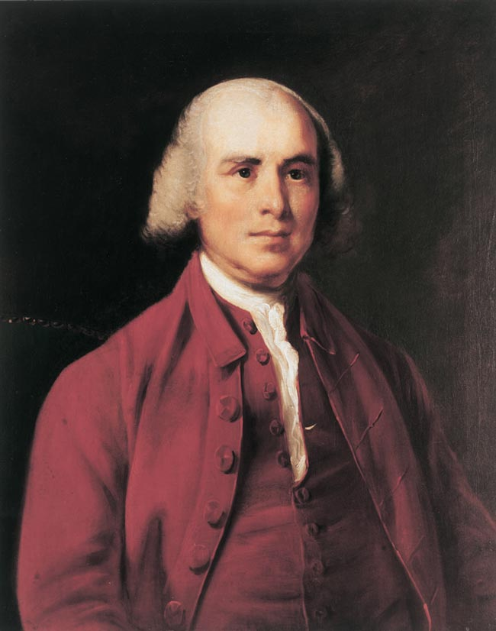
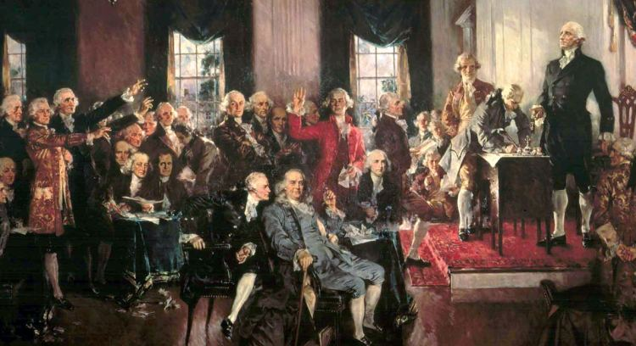
The Constitution
After the Great Compromise, James Madison helps structure the Constitution
James Madison is considered the “Father of the Constitution”
Constitution based on 7 government principles
First time these are put into one government in the world

Slide 4
Discussion
We, the people of the United States, in order to form a more perfect Union, establish justice, insure domestic tranquility, provide for the common defense, promote the general welfare, and secure the blessings of liberty to ourselves and our posterity, do ordain and establish this Constitution for the United States of America.
Which goal do you believe is the most important? Why?
Which goal do you believe the government has failed on? Why?

Slide 5
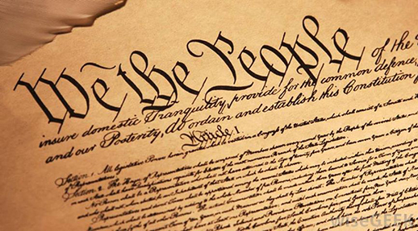
7 Principles of the Constitution
Popular Sovereignty: the People rule; people control the government
Republic: Representative government; people elect other people to represent them in government

Slide 6
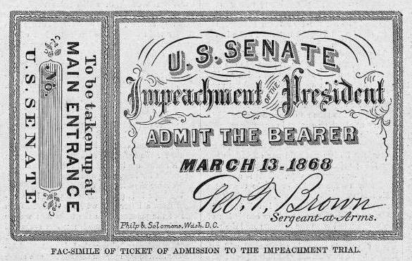
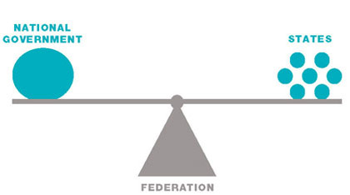
7 Principles of the Constitution
Limited Government: power of government has built in limits; government must follow the rule of law (ex. President can be impeached)
Federalism: power is shared between the state governments and the national government; splits power of governments

Slide 7
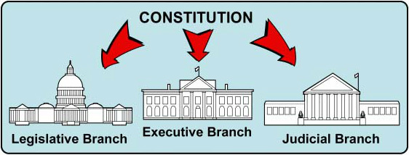
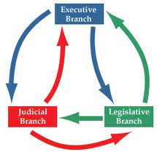
7 Principles of the Constitution
Separation of Powers: national government separated into three branches; split power of government to keep it under control
Checks and Balances: system that allows branches of government to keep each other under control; keep one branch from getting too much power.

Slide 8
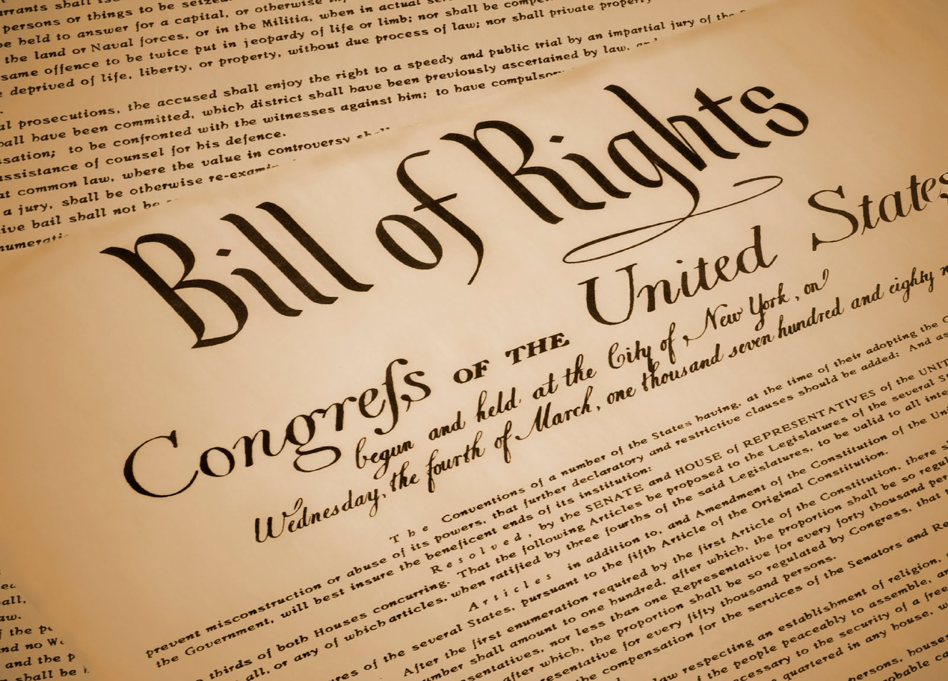
7 Principles of the Constitution
Individual Rights: the people have guaranteed rights that cannot be taken away; Bill of Rights were the first ten amendments of the Constitution
This topic leads to major disagreement

Slide 9
Reflection
Which principle of the Constitution do you believe protects against government getting too much power the best? Explain why.

