Slide 1
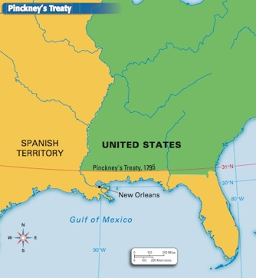
Daily Quiz-10/25
1. The treaty shown on the map secured the
A right of Americans to use the port at New Orleans.
B neutrality of the United States in wars with France.
C return of runaway slaves from the Florida Territory.
D territory west of the Mississippi to American expansion.

Slide 2
Daily Quiz-10/25
2. The Whiskey Rebellion was important in American history because it showed the
A need for a national bank to handle currency problems.
B power of the new central government to keep law and order.
C need for political parties to represent different points of view.
D power of the new navy to protect the coastlines of the country.

Slide 3
Presidency of John Adams

Slide 4
America’s First Political Parties
FEDERALISTS | DEMOCRATIC-REPUBLICANS
Led by Alexander Hamilton Believed nation needed economy based on manufacturing and trade Wanted the government run by the wealthy and educated elite Supported “loose interpretation” of the Constitution | Led by Thomas Jefferson Believed nation needed economy based on agriculture Trusted the “common man” to be informed and capable of sustaining democracy Supported “strict interpretation” of Constitution

Slide 6
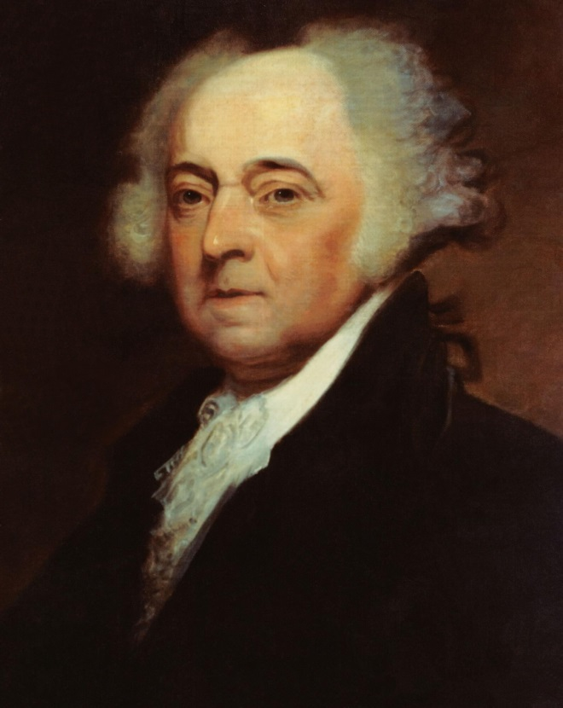
John Adams becomes President
John Adams, Washington’s Vice President and a Federalist, wins the next election.
Adams has problems from the very beginning.

Slide 7
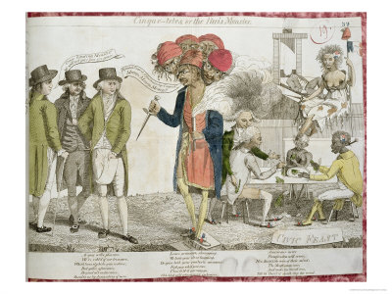
Adams and Foreign Policy
Adams’ biggest problems came from wars between Britain and France
Both begin impressment of US sailors
Adams sends people to France to work things out
XYZ Affair: American ambassadors ignored by French unless they paid a bribe to meet with French officials, upsetting to Americans

Slide 8
Discussion
What is the primary difference between Federalists and Democratic-Republicans?
Why would Americans be so upset about the XYZ Affair? How does it make President Adams look?
What problems could arise from Adams facing some problems at home from Democratic-Republicans?

Slide 9
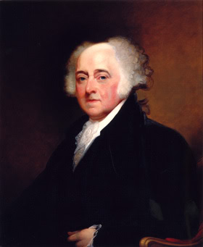
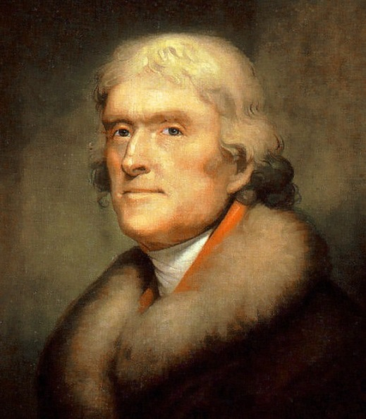
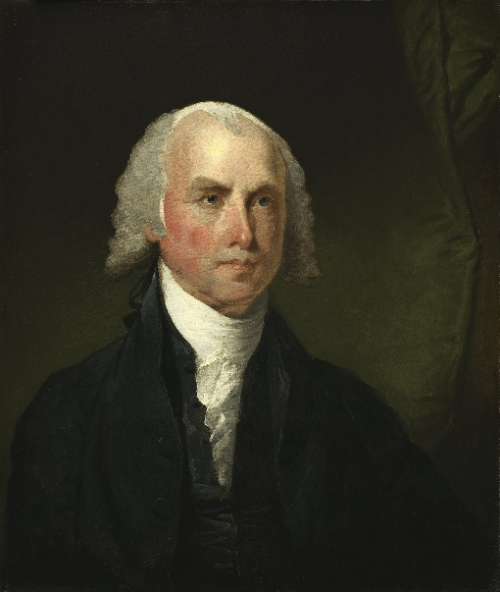
Issues at Home for Adams
Adams being criticized by Democratic-Republicans who favored France.
Adams wants to silence these opponents.
vs.

Slide 10
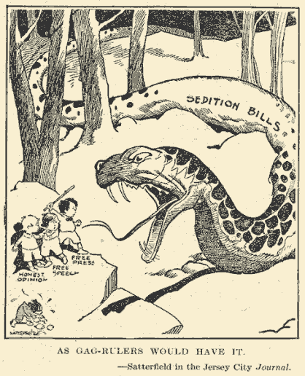
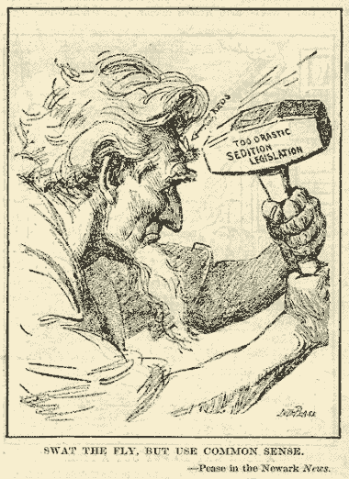
Alien and Sedition Acts
Acts meant to reduce opposition to Federalists
Made it illegal to speak out against the government, kept immigrants (aliens) from becoming citizens
Targeted Democratic Republicans

Slide 11
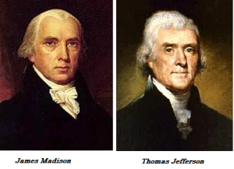
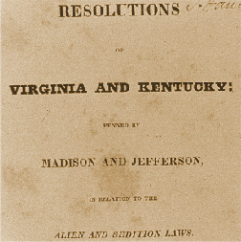
Response to Acts
Jefferson and Madison fought Adams on these issues
Kentucky and Virginia Resolutions: Written by Jefferson and Madison in response to Acts
States’ rights (theory that states have rights over the national government)
Nullification (state rejection of national laws)

Slide 12
Political Cartoons
Do you know which event each political cartoon is about?

Slide 13
Political Cartoon #1

Slide 14
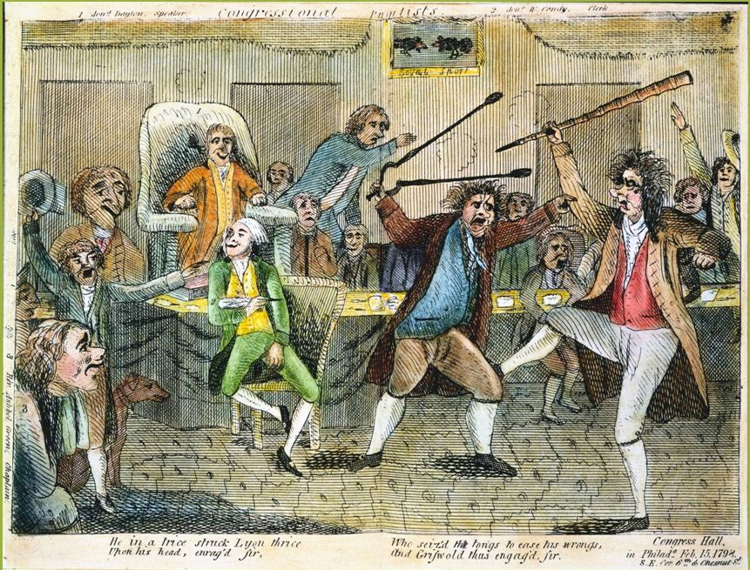
Political Cartoon #2
Matthew Lyon (Blue Vest) was charged with criticizing President Adams

Slide 15
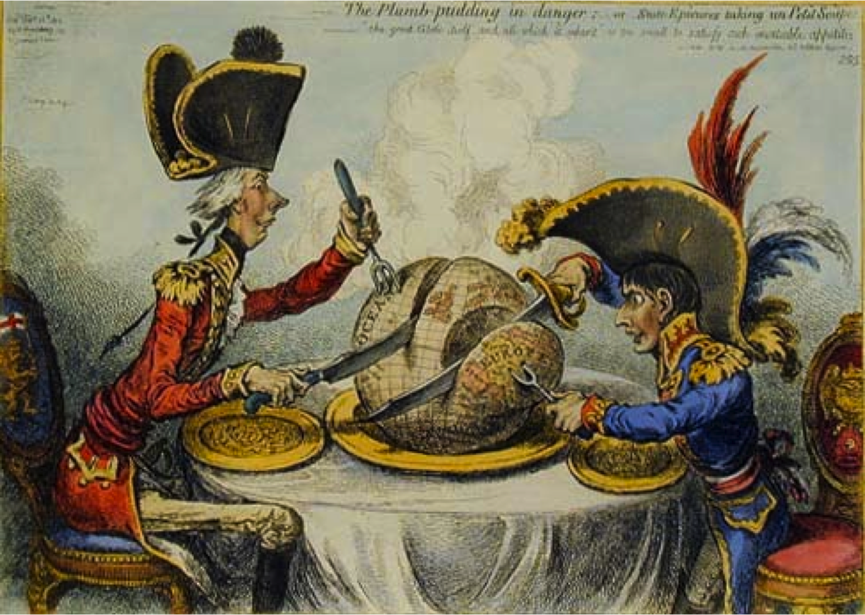
Political Cartoon #3

Slide 16
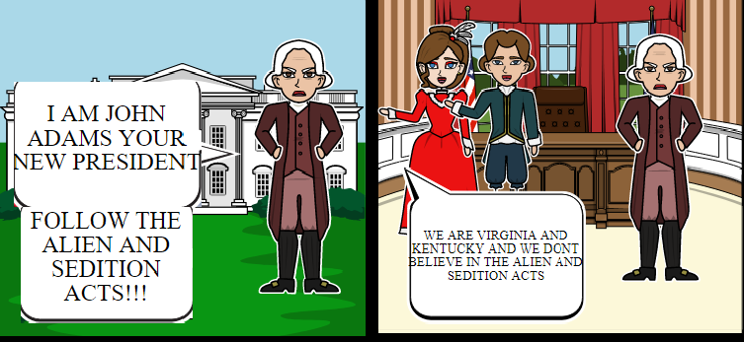
Political Cartoon #4

Slide 17
Political Cartoon #5

Slide 18
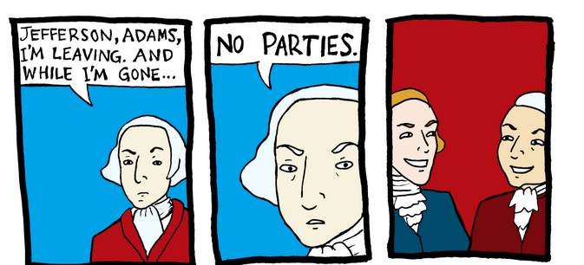
Political Cartoon #6

Slide 19
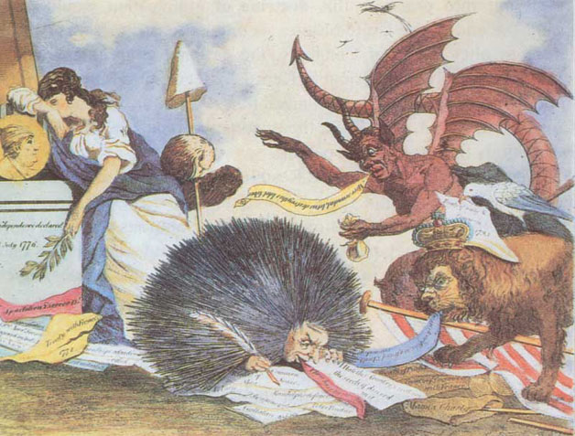
Political Cartoon #7

Slide 20
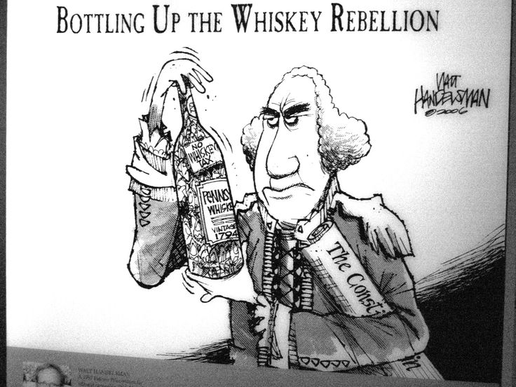
Political Cartoon #8

Slide 21
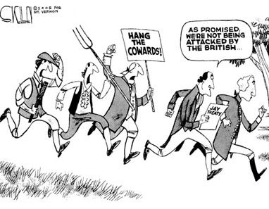
Political Cartoon #9

Slide 22
Reflection
Should Adams be viewed as a good president? Why or why not?

