Slide 1
Jeffersonian Growth

Slide 2
France causing Problems
Napoleon Bonaparte had taken full control of France
Britain had declared war and conflict was in full swing
Since Spain was trash, they had given the Louisiana Territory back to France
They feared war with Napoleon (which happened anyway)
Jefferson was worried that war hungry Napoleon would attempt to attack America
Or take away our use of the Mississippi River and New Orleans
Pinckney’s Treaty was with Spain and no longer applies

Slide 3
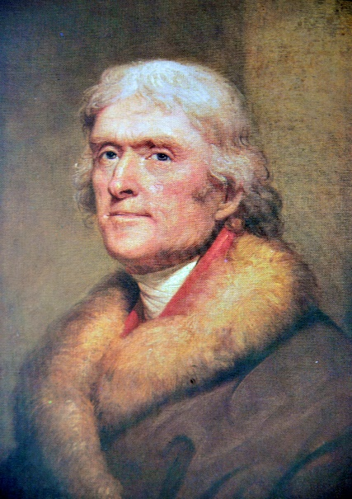
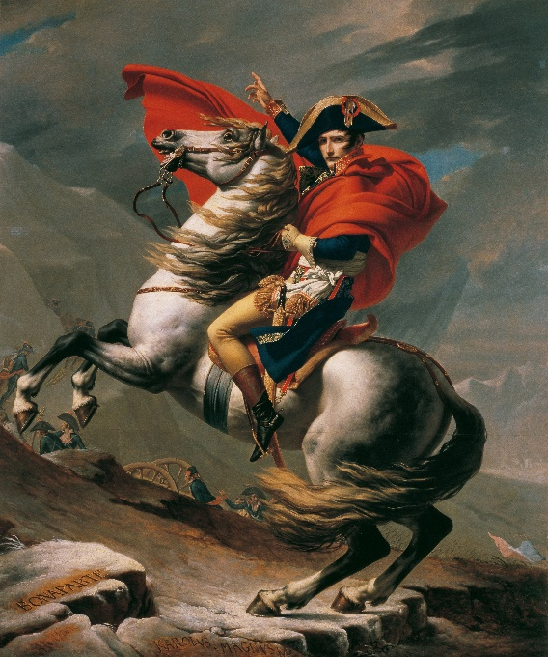
Louisiana Purchase
Jefferson asked to buy New Orleans from France, Napoleon offered all of Louisiana
Jefferson struggled:
Wanted the land
Conflicted with his strict interpretation of Constitution
Jefferson decided to purchase Louisiana even though it was not power given in Constitution
Doubled the size of the country
Gave use tons of resources
Hamilton even believed this was a good idea

Slide 4
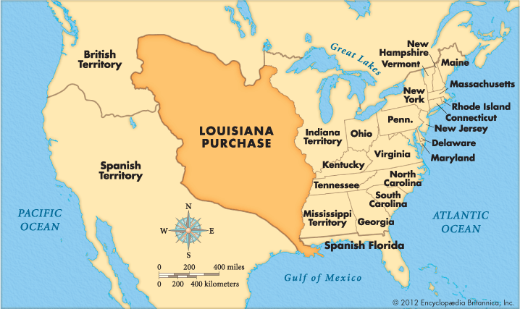

Slide 5
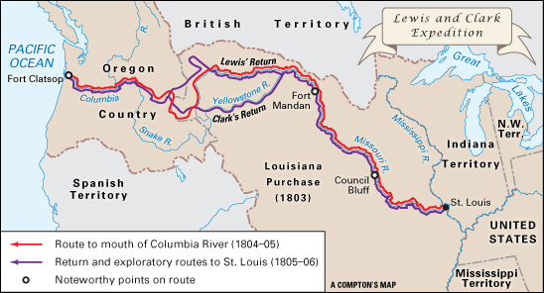
Lewis and Clark Expedition
Jefferson asked Lewis and Clark to explore the new territory
Used the rivers to get west (Missouri River)
Purposes:
Take inventory of the land purchased
Gather info on new plants and animals
Map the territory
Establish relationship with Western Indians (Sacagawea)
She helped Lewis and Clark navigate and interact with Native American tribes

Slide 6
Reflection
What were the 2 purposes of the Lewis and Clark expedition?

