Slide 1
French and Indian War

Slide 2
Differences in Colonies
French colonies: New France (small population)
Primarily Catholic
Economy focused on Fur trade (with Native Americans)
Controlled land west of Appalachian Mountains
Ohio and Mississippi River Valleys
British colonies: 13 Colonies (large population)
Many different religions
Economy is very diverse
Stuck along the east coast of North America (want land)
Tensions over the land in the Ohio River Valley leads to conflict

Slide 3
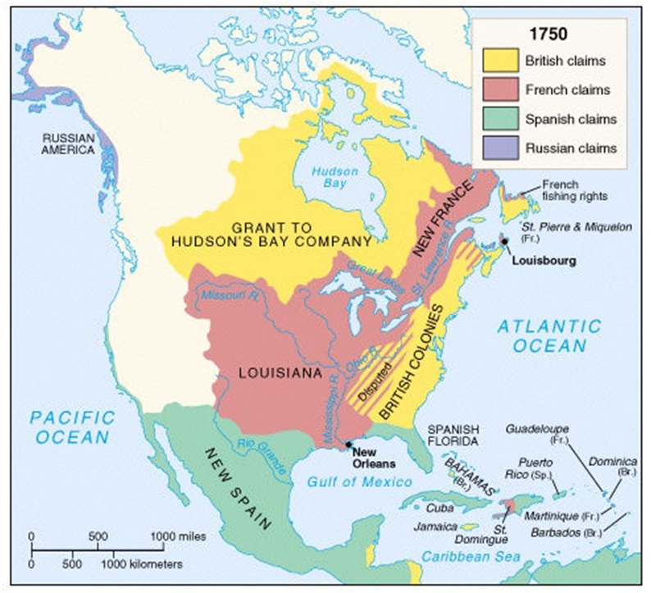
Ohio Valley

Slide 4
T-Chart
Make a T-Chart in your notes
British Colonies v. New France Colony
British Colonies New France

Slide 5
Place the following descriptions under either the British Colonies or New France
T Chart
Large population
Mostly Catholic
fur traders
diverse economy
needed more land
controlled Ohio Valley
many different religions
small population
got along with Natives
Conflict with Natives

Slide 6
T Chart
British Colonies New France
Large population
small population
diverse economy
fur traders
needed more land
controlled Ohio Valley
many different religions
Mostly Catholic
Conflict with Natives
got along with Natives

Slide 7
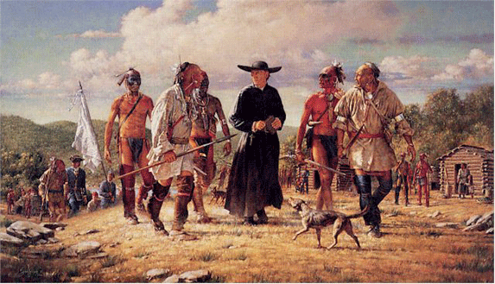
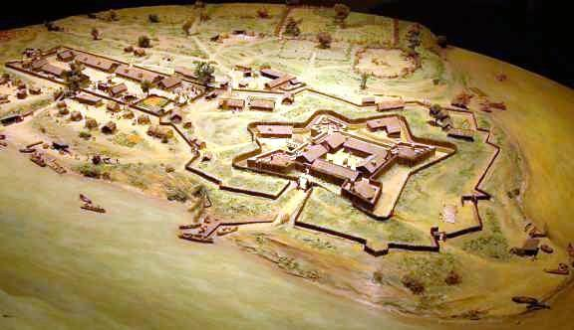
France v. Britain
Both form alliances with Native Americans
British: Iroquois Confederacy (in New York)
French: Huron Indians (in Great Lakes)
Both assumed the other was after their land
Both begin building forts along the border between New France and British colonies

Slide 8
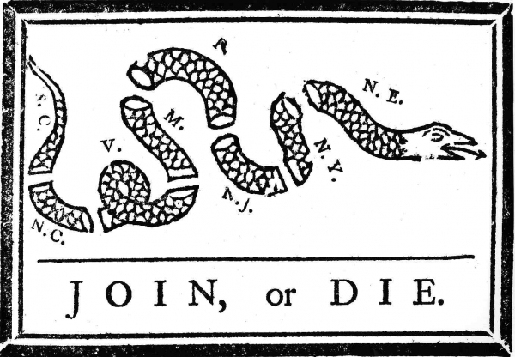
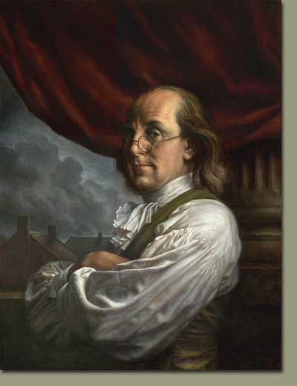
Uniting the Colonists maybe
Colonist leaders met in Albany, New York
Benjamin Franklin, a colonist inventor and leader proposed the Albany Plan
Plan to unite colonies together to defend against the French and Native Americans (the plan failed; no colony wanted to give up power)

Slide 9
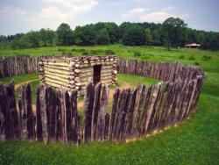
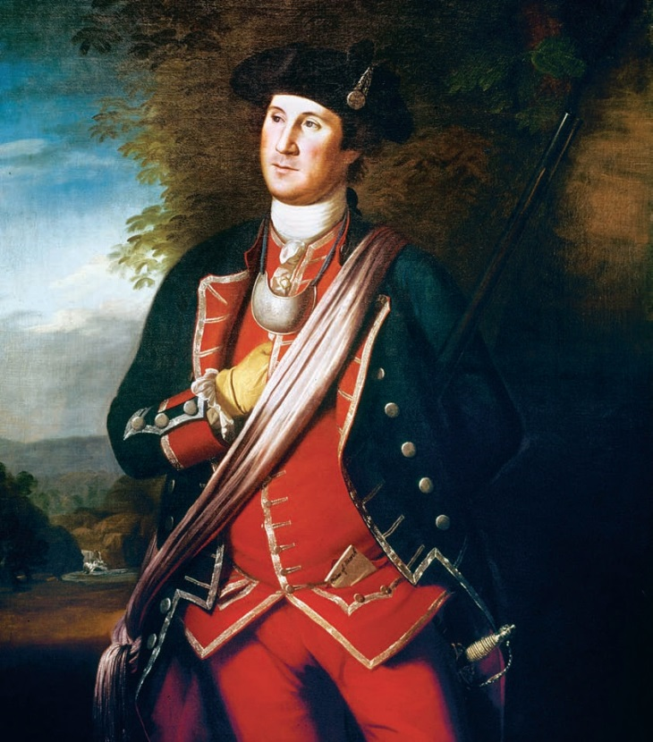
War Breaks out
George Washington, a colonist military officer led a militia towards a French fort in Pennsylvania
His men construct Fort Necessity (very poor fort)
This fort is easily over taken by the French
Washington’s defeat leads Britain to send an army to fight in the colonies

Slide 10
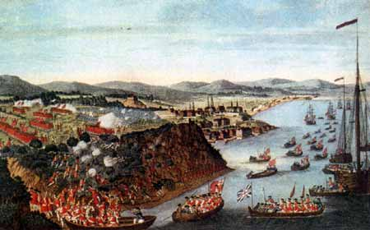
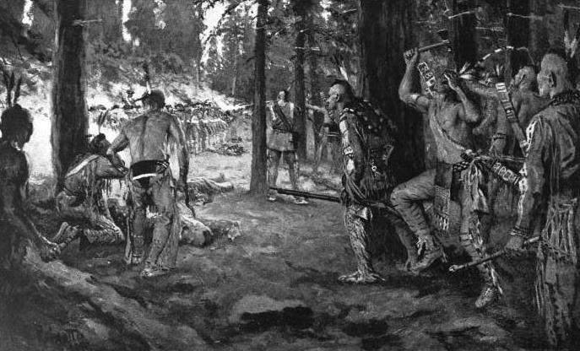
Course of the War
British focused on Ohio Valley at first
Britain struggled early, losing many battles
French get assistance here from Native allies
Massacre at Fort Loudoun: Cherokee Indians massacre a British fort in present day Tennessee
Strategy shifts to attacking major French cities
Montreal and Quebec City in Canada
Britain takes the cities and forces France to surrender

Slide 11
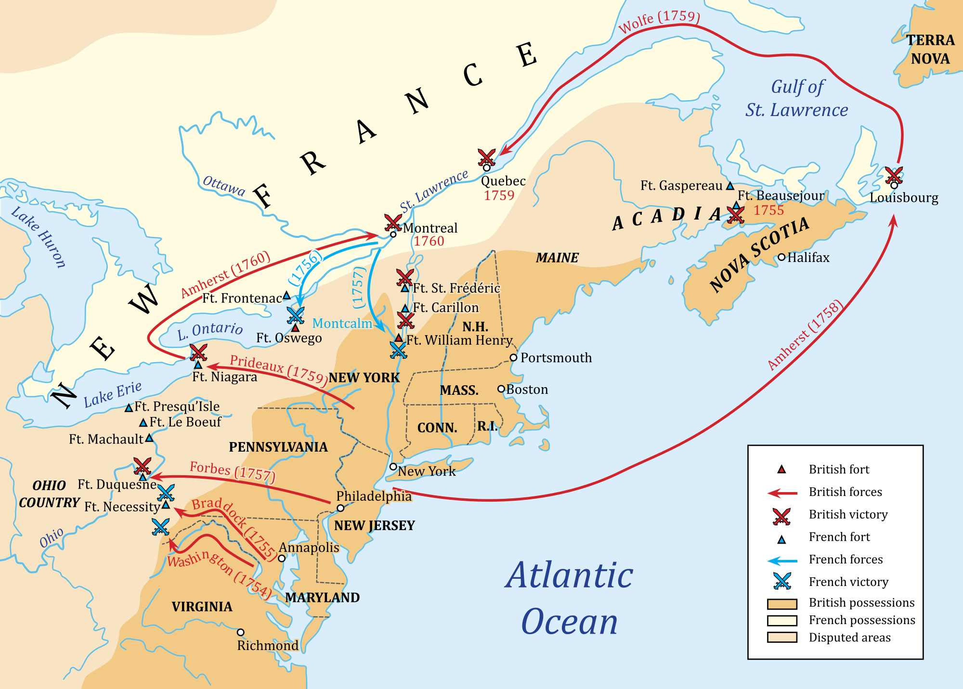

Slide 12
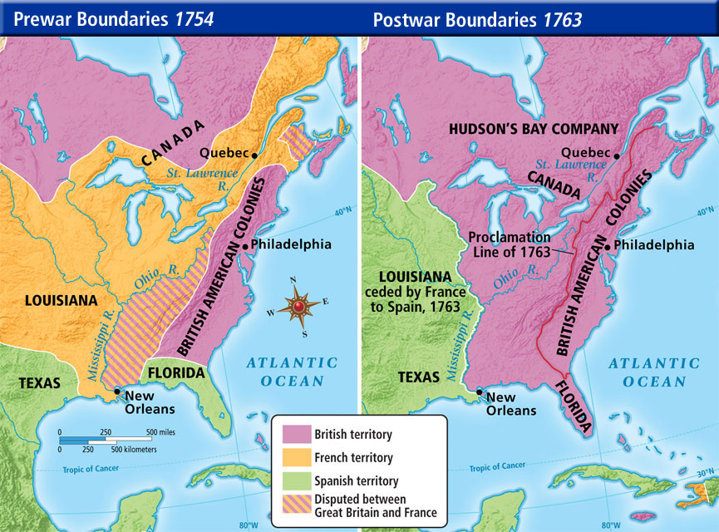
Effects of the War
France loses control of Canada and Ohio Valley
Britain gets all their land (Treaty of Paris)
British colonists free of fear of French
Colonists believe they can move west

Slide 13
Reflection
What was a major impact of the French and Indian War?

