Slide 1
First American Colonies

Slide 2
Motivation to Move
GGGP
God: Religious Freedom
People were persecuted if their beliefs differed from “norm” (Reformation)
Gold:
People with more money, invested in Joint Stock Company (company where investors buy stock in return for future profit)
Funded colonies in New World
Glory: Claiming land for one’s country
Population Surplus:
Too many people in Europe, poor looking for new opportunity

Slide 3
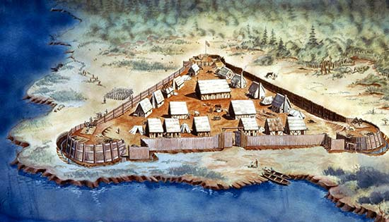
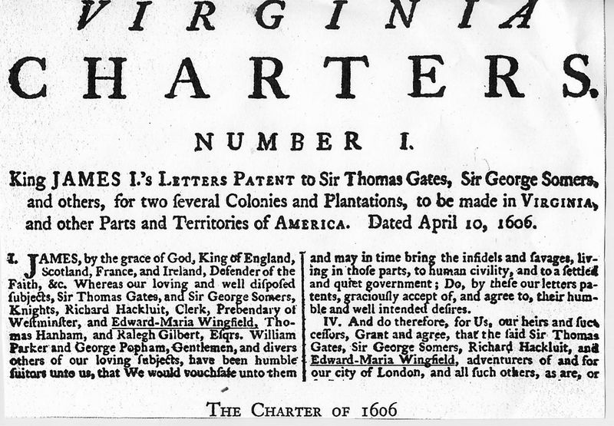
Jamestown
A charter (written permission from the King to start a colony; King has distant control) was given to the Virginia Company
Joint Stock Company
Settled colony in Virginia

Slide 4
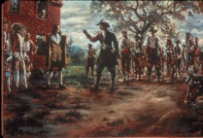
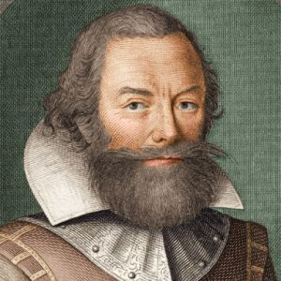
Jamestown Struggles
Motive for Virginia company is to make money
Search for Resources: Gold and other metals
No one planned to stay
They were unprepared for harsh conditions
John Smith forced colonists to farm and build structures to live

Slide 5
Discussion
What are the motivations for settlers moving to the New World?
Who funded the Jamestown colony? How might that impact their goals?
What do you believe would happen to Jamestown without John Smith?

Slide 6
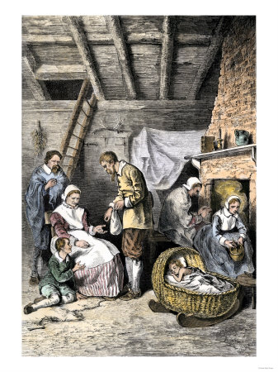
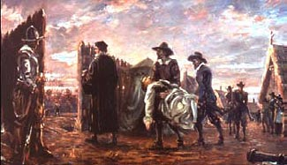
Trouble and Success
Smith received help from the local native peoples, the Powhatan
When Smith returns to Britain and the Powhatan stop helping, colonists begin to starve
“Starving time”- Jamestown starved
Jamestown survives and expands

Slide 7
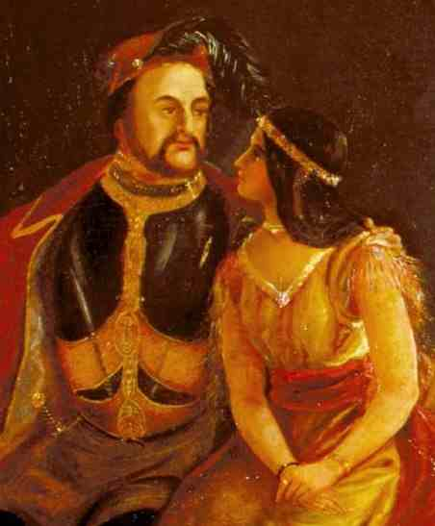
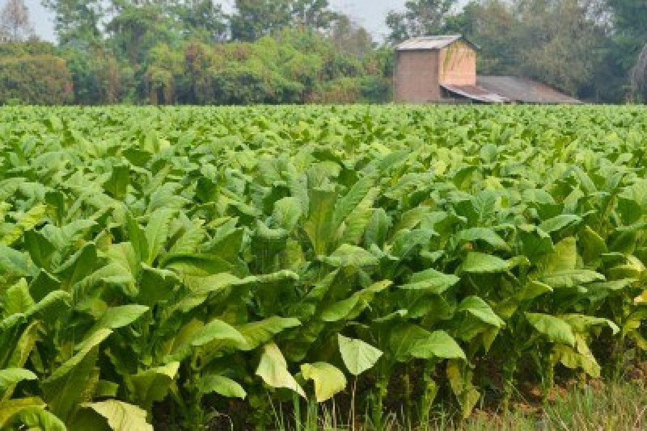
Expansion of Jamestown
Pocahontas (a Powhatan) marries John Rolfe and attempt to unite the colonists and natives
John Rolfe found way to cure tobacco. Tobacco becomes Jamestown’s “gold”
Virginia Company begins giving land to English people willing to stay in colonies

Slide 8
Reflection
What were the primary motivations behind people moving to the New World? How may the actions of people with different motivations impact the colonies?

