Slide 1
Debating the Constitution

Slide 2
What the Constitution Created
New National Government
Three Branches
Legislative Branch: Congress-> power to MAKE the laws
Executive Branch: President and government workers-> power to EXECUTE the laws
Judicial Branch: Supreme Court -> power to JUDGE the laws; can rule laws unconstitutional
Each Branch given ability to limit other branches powers
Examples: Congress impeaching the President, President veto laws, Court ruling laws/actions unconstitutional
Federalism
Enumerated Powers: powers specifically given to national government
Reserved Powers: Any power not specifically given to national government; states have these

Slide 3
Not so fast…
When the Constitution came up to be voted on by the States for approval, two sides formed over these issues:
No Bill of Rights: originally the Constitution had no guaranteed rights for the people; Madison and others believed the government was limited by design
“Necessary and Proper” clause: gave Congress “implied powers” meaning it allowed them to have powers they believed they needed to do their job; many worried this would let government get too strong
Supremacy clause: National government is supreme to the states
States lost A LOT of freedom and power

Slide 4
Discussion
What was the intended purpose to create separate branches of the government?
What is the difference between enumerated and reserved powers?
Assess the “necessary and proper” clause. (What could be good about it? What could be bad about it? Then decide if it would be worth it.)

Slide 5
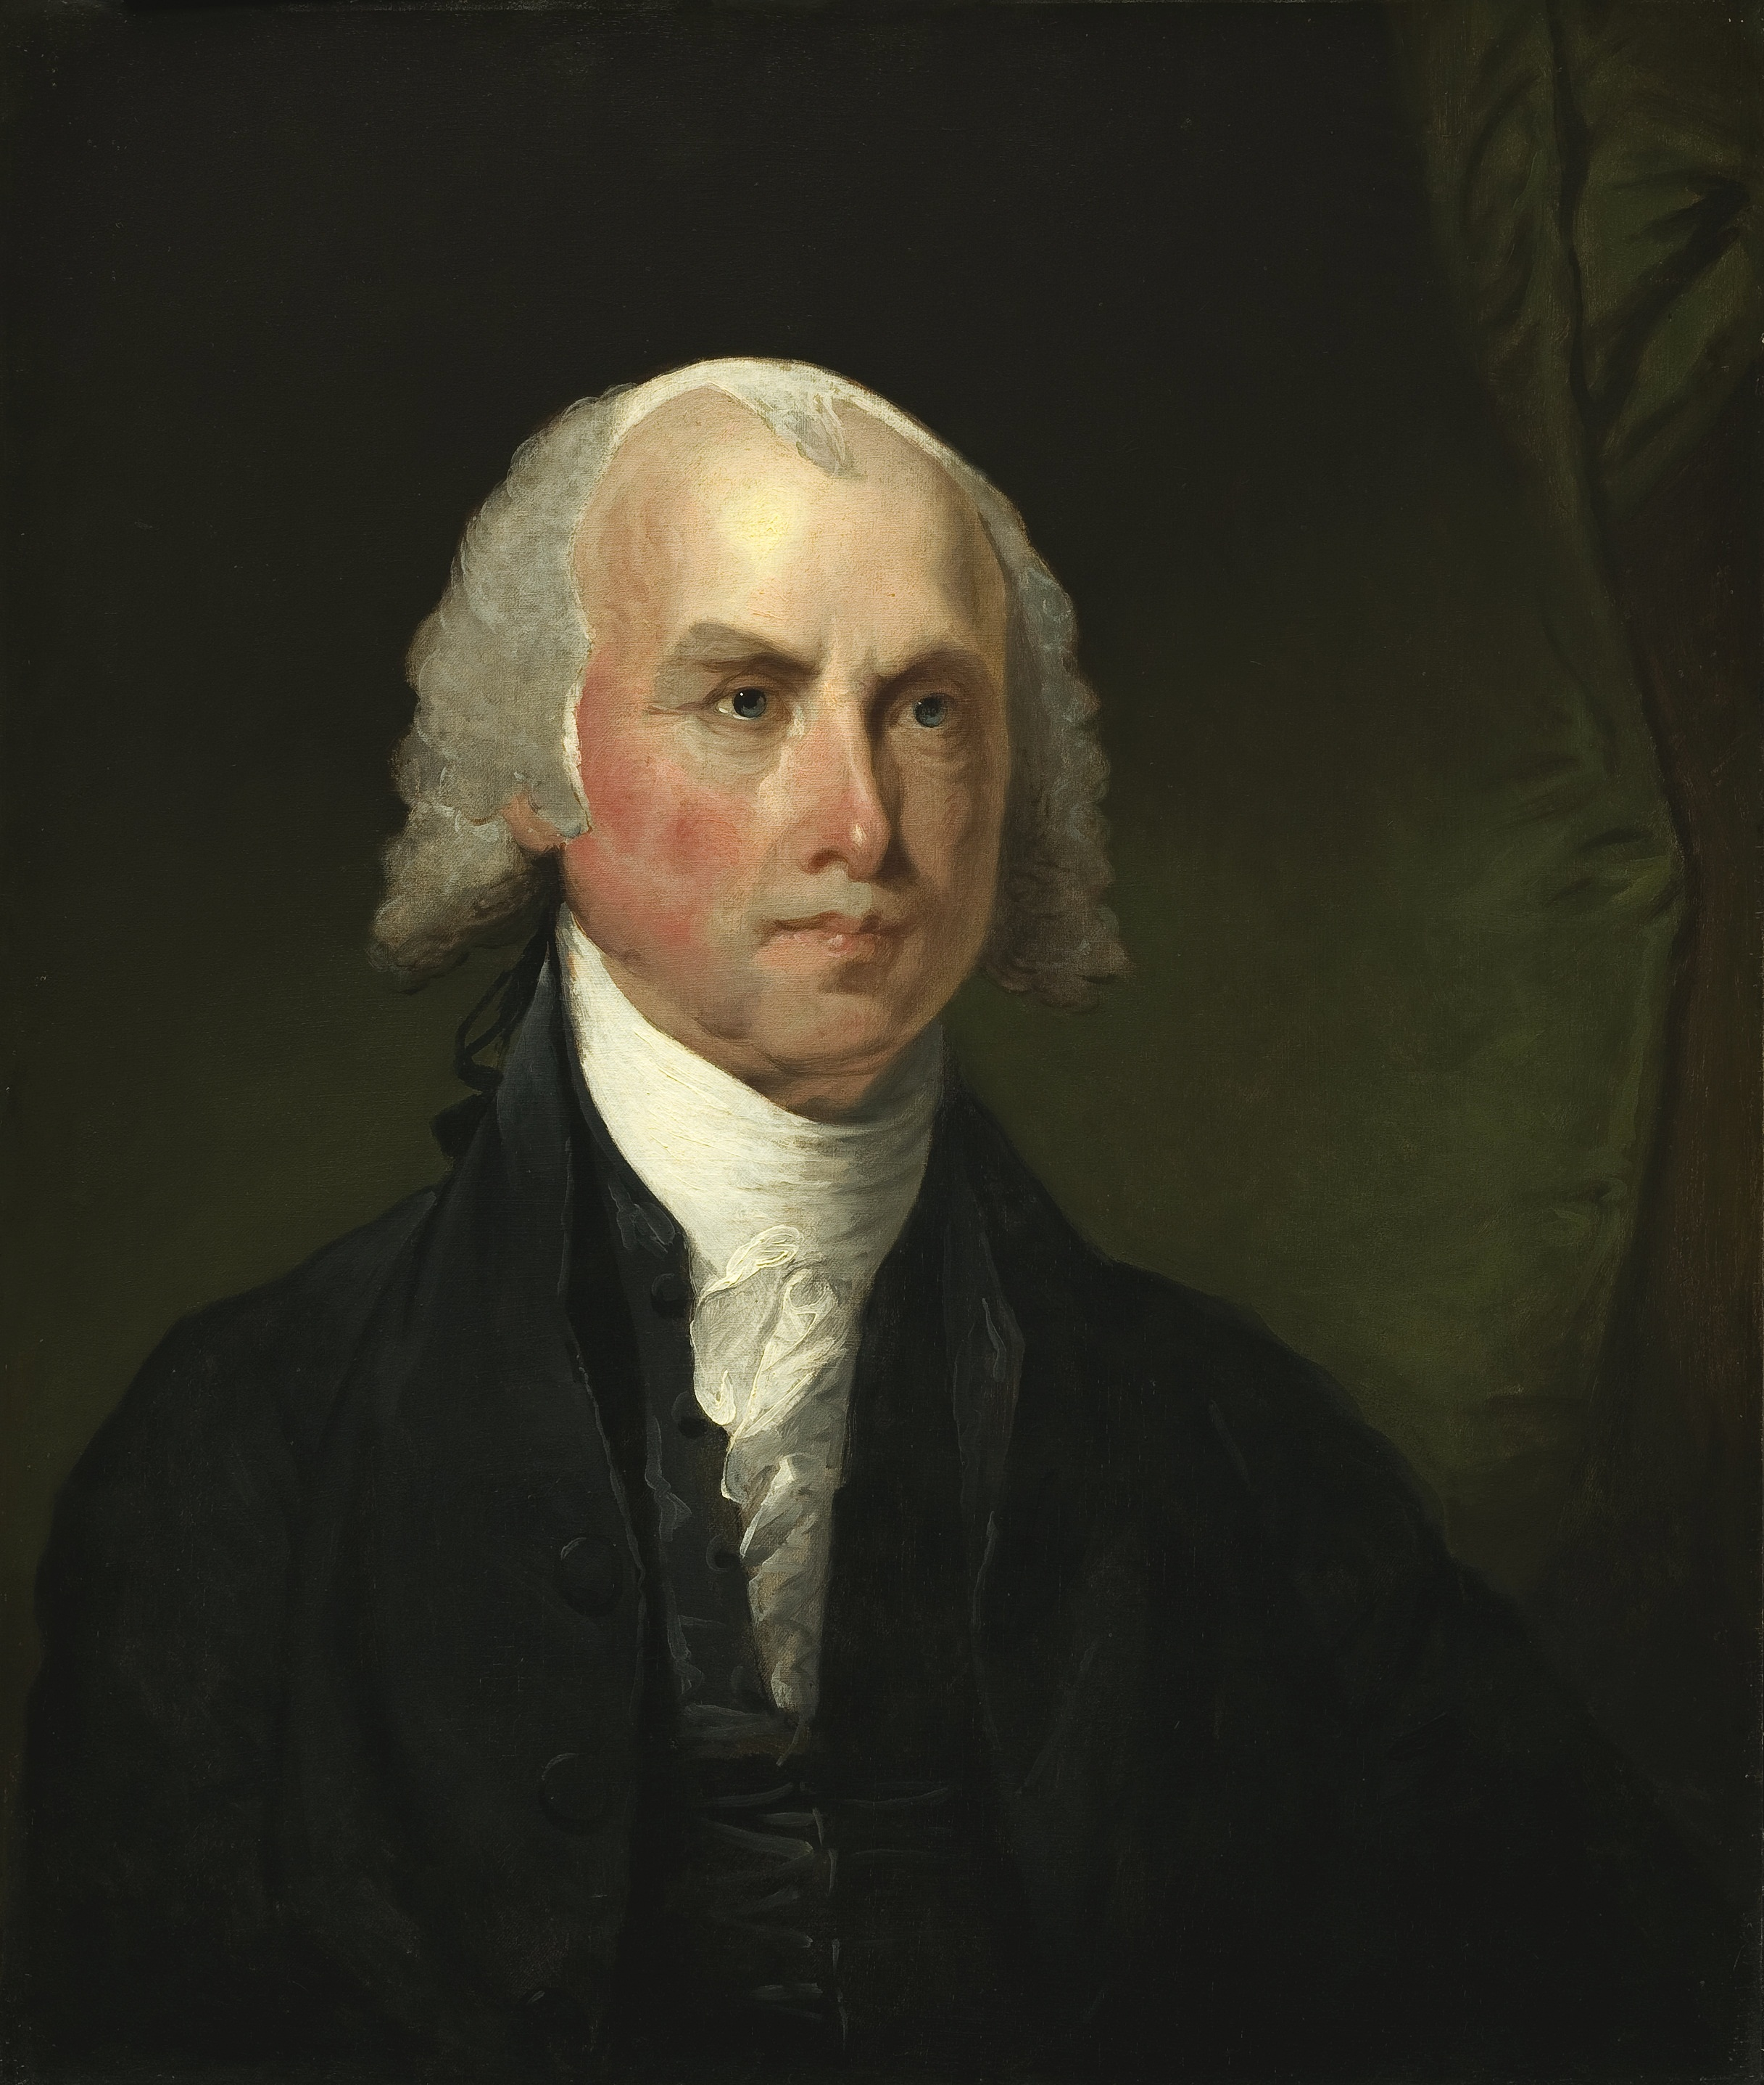
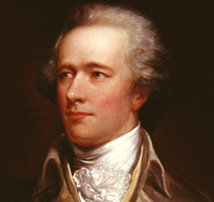
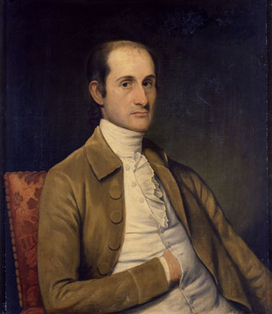
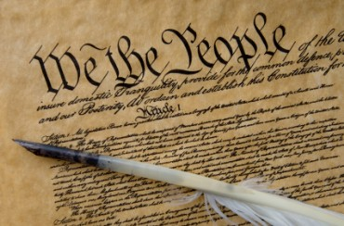
Federalists
Group of people who believe the Constitution should be approved (ratified)
Beliefs:
Did not believe a Bill of Rights was needed
The principle of Constitution would protect the people
Bill of Rights is too specific, cannot include all rights
Supported the “necessary and proper” clause
Allowed Congress to work well and get things done
Believed they allowed states to keep some power (reserved powers) but not too much

Slide 6
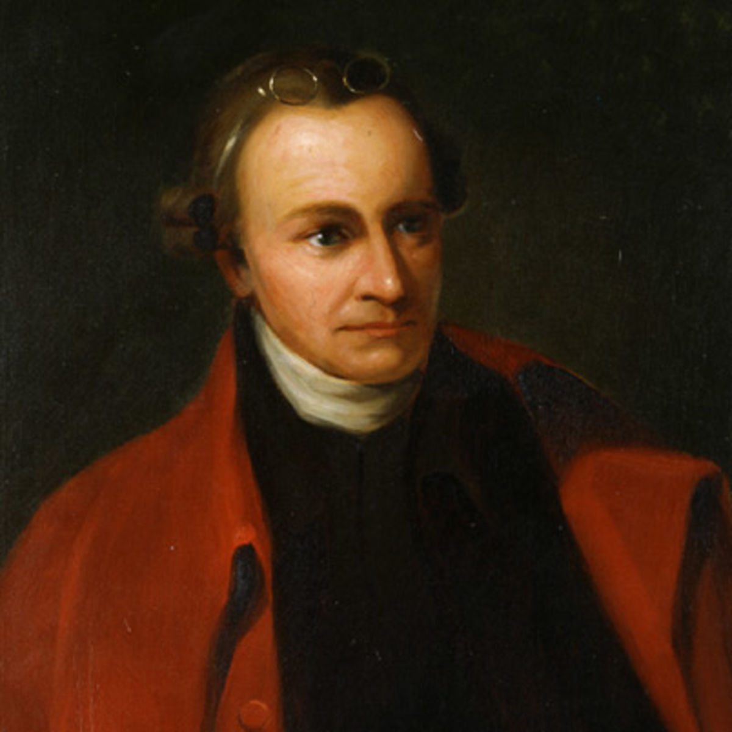
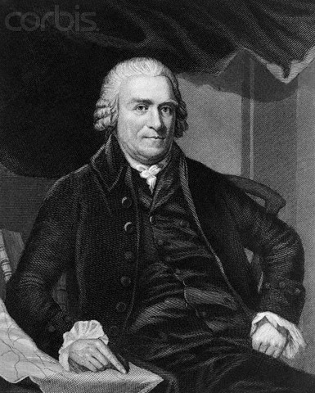
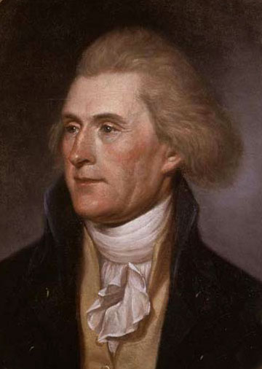
Anti Federalists
Group of people against the approval of the Constitution unless it had certain changes
Beliefs:
Bill of Rights absolutely necessary
Without it, government could abuse the people(remember Britain?)
Against the “necessary and proper” clause
Believed it was a permission slip that allowed government to get more power
Wanted states to keep more power; ensure limited national government

Slide 7
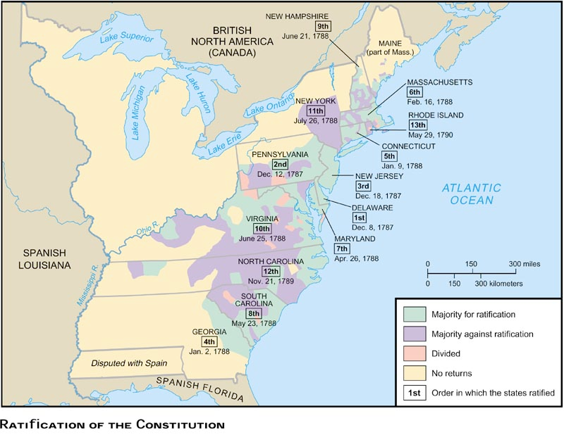

Slide 8
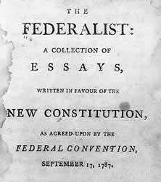
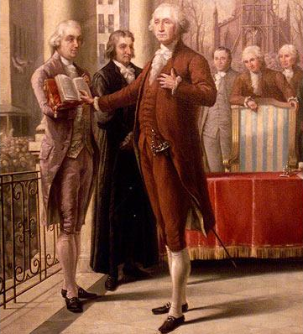
The Debate
Federalists wanted to gain support for the Constitution
Lead Federalists printed numerous essays in New York newspapers to convince people
Federalist Papers: written by James Madison, Alexander Hamilton and John Jay; defended Constitution
Anti Federalists were less organized but wrote their own letters and speeches warning against the government having too much power
The debate came down to a Bill of Rights
Federalists agreed to add it after the Constitution was approved;
anti Federalists agreed

Slide 9
The Federalist Papers
Federalist 51 by James Madison from The Federalist Papers:
“If men were angels, no government would be necessary. If angels were to govern men, [no controls] on government would be necessary. In framing a government which is to be administered by men over men, the great difficulty lies in this: you must first enable the government to control the governed; and in the next place oblige it to control itself. A dependence on the people is, no doubt, the primary control on the government;”

Slide 10
The Federalist Papers
Federalist 51 by James Madison from The Federalist Papers:
“It is of great importance in a republic not only to guard the society against the oppression of its rulers, but to guard one part of the society against the injustice of the other part. Different interests necessarily exist in different classes of citizens. If a majority be united by a common interest, the rights of the minority will be insecure…Whilst all authority in it will be derived from and dependent on the society, the society itself will be broken into so many parts, interests, and classes of citizens, that the rights of individuals, or of the minority, will be in little danger from interested combinations of the majority.”

Slide 11
Reflection
Which side do you believe had the better argument, Federalists or anti Federalists? Why?

