Slide 1
Clear Targets
8.11
Describe the role of the Great Awakening on the growth of religious tolerance and free exercise of religion.
8.12
Compare and Contrast the role of men, women, children, and indentured servants in various regions of colonial America.

Slide 2
Colonial Culture

Slide 3
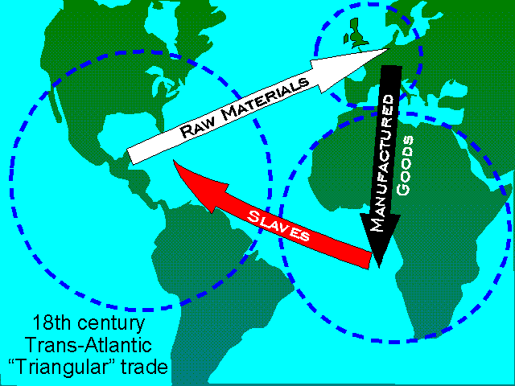
Triangular Trade
Triangular trade: trade routes between three destinations West Africa, Europe and the Americas

Slide 4
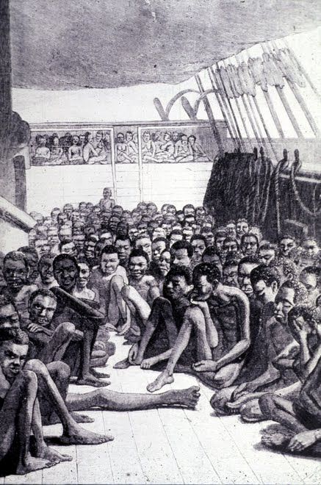
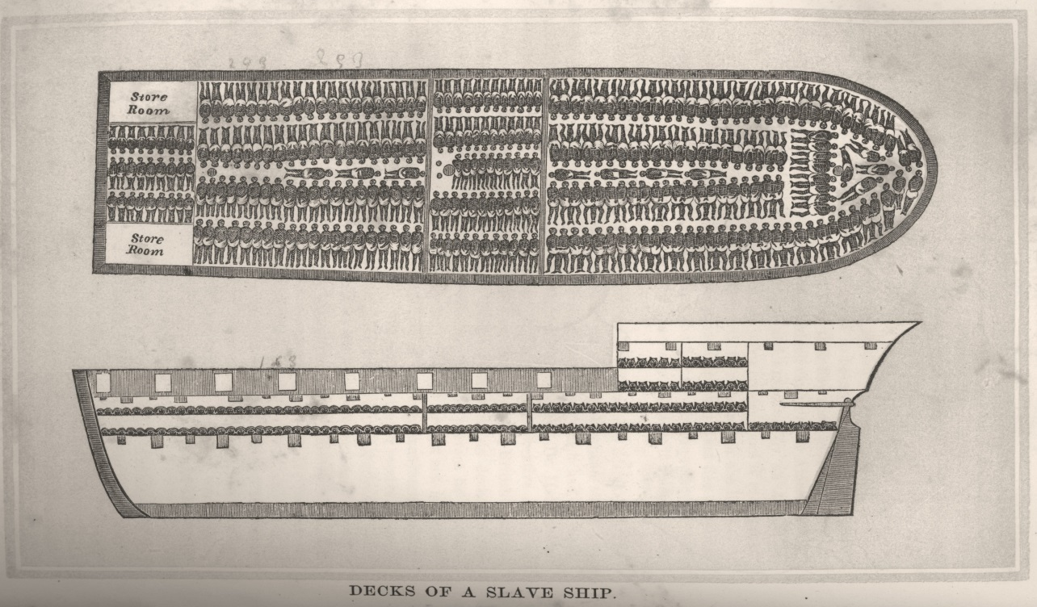
Middle Passage
Passage of slaves from Africa to the Americas
Very terrible conditions-lasted over a month
Chained together
Little food or water
Unsanitary

Slide 5
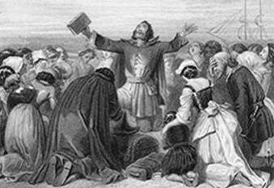
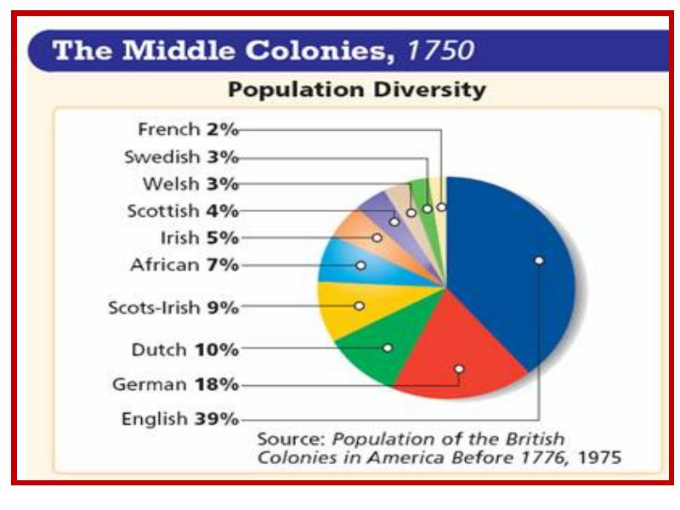
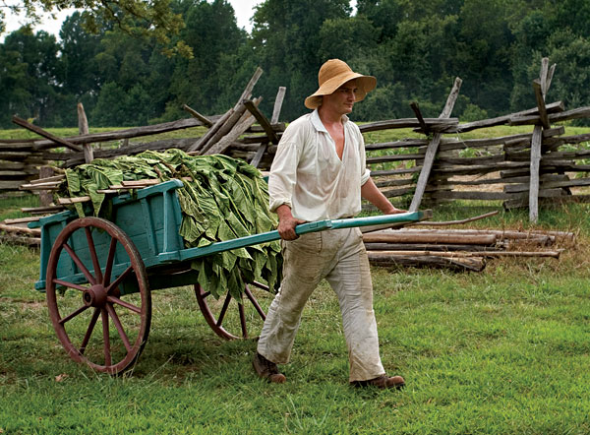
Colonial Life
Life is difficult
All about survival
New England
Very Religious
Highly Educated
Middle
Major cities=Diversity
South
Large gap between rich and poor

Slide 6
Discussion
What caused the rise in demand for slaves in the American colonies?
How would you describe life for colonists?
How would such a hard working people have time for things like religion?

Slide 7
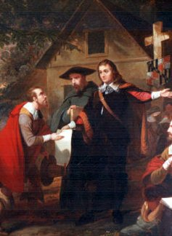
Religion
Maryland Toleration Act: Created an increase in religious freedom and more tolerance for other religions (as long as they are Christian)
Salem Witch Trials: series of trials where people were accused of being witches
Led to downfall of Theocracy

Slide 8
Religion
The Great Awakening: religious revival of the 1730’s and 1740’s
A “new birth” of faith and renewed commitment to God
Preachers like Jonathan Edwards and George Whitefield inspired thousands
Effects:
New churches (Methodists, Baptists)
Belief that all people are equal before God
Actions matter (good deeds => Heaven)
United colonists (shared experience)
Lessened differences

Slide 9
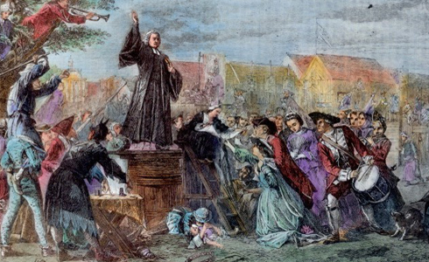
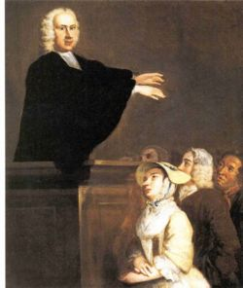
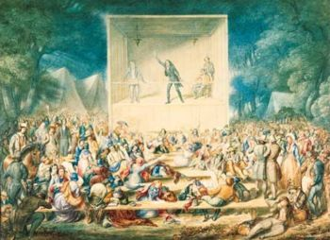

Slide 10
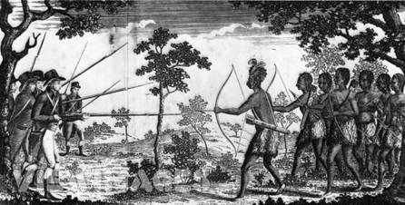
Native Americans
Conflict over Land
Europeans believed in private property
Natives believed land is a shared resource that everyone can use
King Philip’s War: conflict between Indians and New England colonists
Disease
Lack of immunity to European disease kills a majority of Indians
Small pox
Measles
Flu

Slide 11
Reflection
How can changes in religion change other aspects of life?

