Slide 1
Articles of Confederation

Slide 2
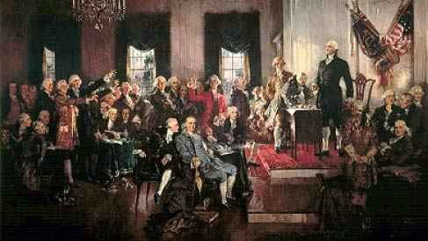
Need for Government
Colonists needed a government after leaving Britain
Colonists wanted: (all things that they didn’t have under Britain)
Self government= no King
Limits to government power= states’ rights
Protected rights for citizens

Slide 3
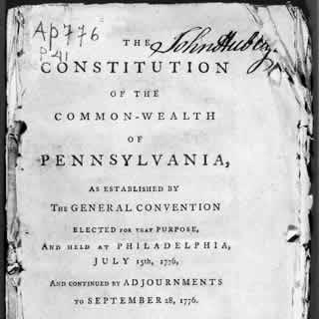
Colonial Governments
All colonies had representative governments and constitutions
Often these constitutions left power to the people to elect representatives
Now they decided to make a national government
Colonial governments could not decide on ways to interact with each other

Slide 4
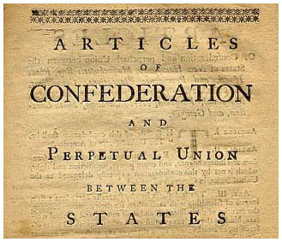
Solution
Articles of Confederation- First government of the United States of America
Created during Revolution
Weak connection of states with a Congress to make decisions; no executive (king)

Slide 5
Discussion
How did the colonies make decisions during the Revolutionary War?
Why did the colonies choose to create a government like the Articles of Confederation?
Predict some problems that could arise from the government they created.

Slide 6
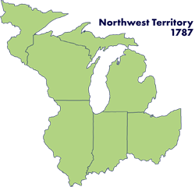
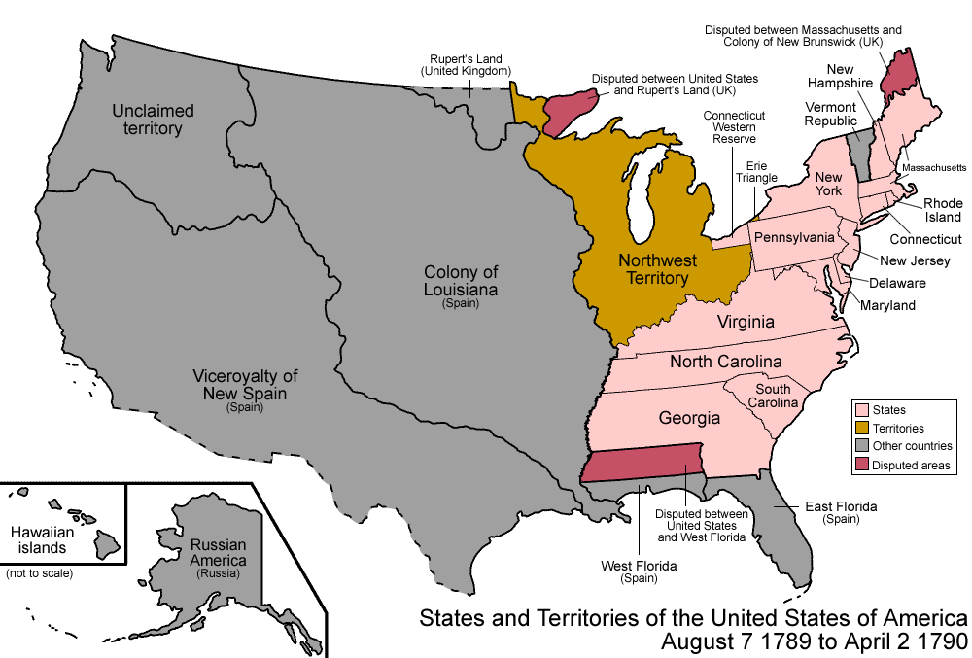
Successes under Articles
After the Revolution, the government was in the spotlight.
What would it do with all that new land it had
It created policies for new western lands
Land Ordinance of 1785: Set up how the land would be divided
Northwest Ordinance: established how lands (Northwest territory) could be sold (all money going to government); prohibited slavery in the territory

Slide 7
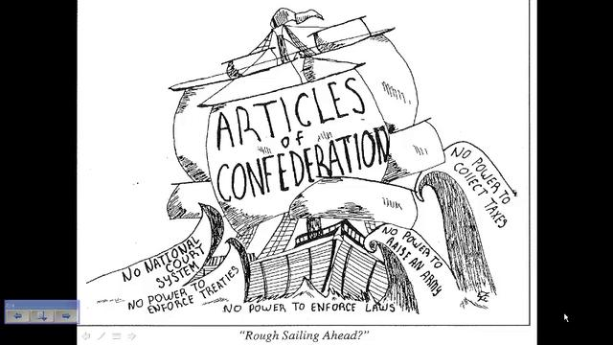
Weaknesses of the Articles
Due to the fear of repeating the errors with Britain, the government under the Articles had serious issues
Cannot tax the people=cannot make money
Cannot control business (commerce) between states
No executive (no president or king figure) and no court system
Cannot force states to follow laws (states have more power)
Cannot make changes to government (if something wasn’t working, they needed everyone to agree to change it)

Slide 8
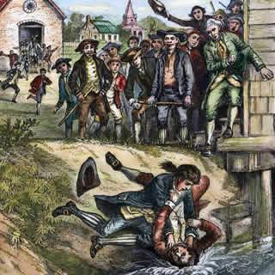
Weakness Shows
The Articles were bound to fail due to their weakness
Question was what would cause the weakness to show
Shays Rebellion
Farmer rebellion in Massachusetts
Farmers upset they are in debt, losing land and government is not helping them
Many owed money by government for service in military
Effects
Rebellion eventually ended
American leaders realize Articles are too weak to enforce laws/help the people

Slide 9
Reflection
How would you fix the Articles of Confederation?

