Slide 1
Daily Quiz 11/29
Negotiated treaties with Indians to cede land in the Northwest Territory
Defeated Tecumseh at the Battle of Tippecanoe
Secured the northwest boundary of the U.S. at the Battle of the Thames in the War of 1812
1. Who is described in the sequence above?
A Henry Clay
B Andrew Jackson
C Oliver Hazard Perry
D William Henry Harrison

Slide 2
Daily Quiz 11/29
2. Which American leader led militia and frontiersmen to victory over the British at New Orleans in 1814?
A Henry Clay
B Andrew Jackson
C Oliver Hazard Perry
D William Henry Harrison

Slide 3
Daily Quiz 11/29
War of 1812
?
3. Which outcome completes the diagram?
A increased unity and nationalism
B expansion of national boundaries
C settlement of the Oregon boundary
D decreased manufacturing in New England

Slide 4
America’s Foreign Policy

Slide 5
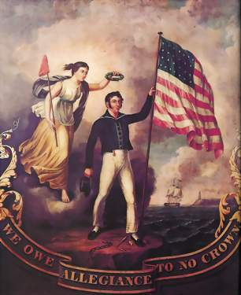
Nationalism
Nationalism was a major impact of the War of 1812
Strong belief in one’s country; a desire to unite and do what is best for the nation as a whole
As the nation began to establish itself, especially after the war, more and more people rallied around the idea of America
Why would the War of 1812 lead to a rise in nationalism?

Slide 6
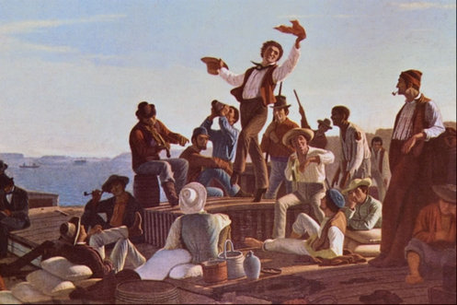
Era of Good Feelings
Period of time when the Federalist Party collapses and fades away
Primarily due to the lack of leaders (Hamilton was killed) and opposition to the War of 1812
Everyone a Democratic-Republican (sorta)
Federalists didn’t go away they just joined the Democratic-Republicans and brought their ideas
Lack of political issues at home leads to a focus on foreign affairs
New President James Monroe is elected and focuses on foreign affairs
Why did the Era of Good Feelings happen? Do you predict it will last?

Slide 7
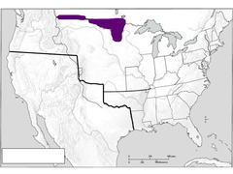
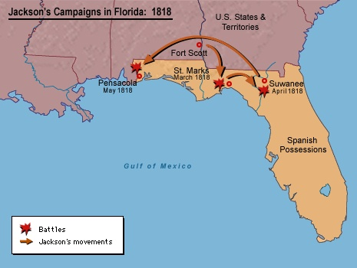
Establishing National Borders
With the rise in Nationalism, people wanted to expand and grow the nation
First, they needed to know what was already theirs
Convention of 1818: Britain cedes (gave up) land to the U.S.
Defined border between U.S. and Canada
Adams-Onis Treaty: Treaty with Spain to give the US control over Florida
Helped by Andrew Jackson’s attacks on Natives in Florida

Slide 8
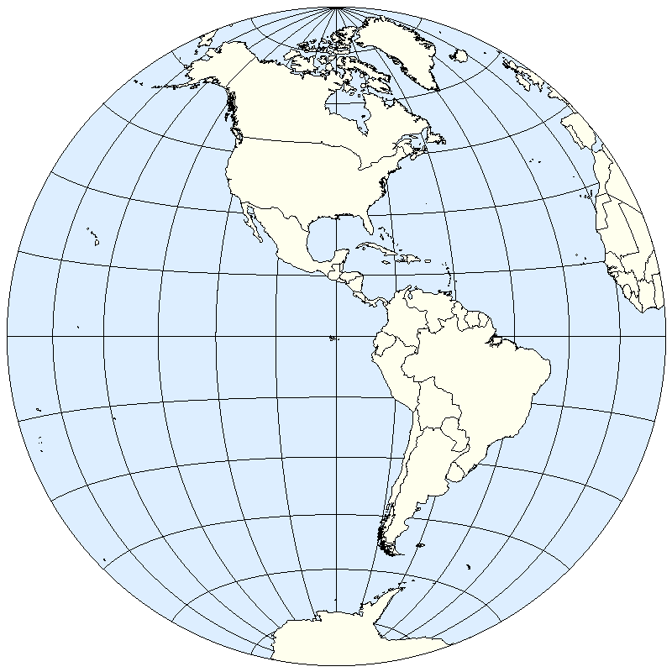
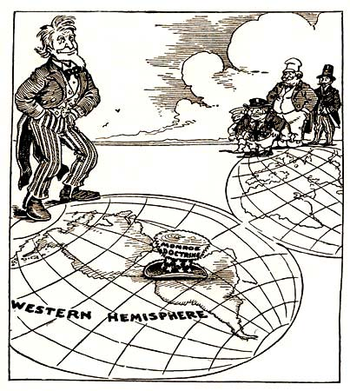
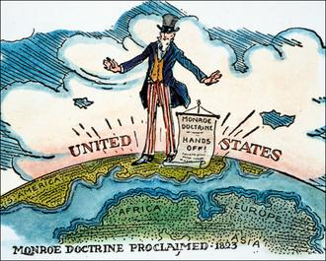
Monroe Doctrine
President Monroe used the rise of Nationalism to declare his Monroe Doctrine
Laid out two things about European interference with the western hemisphere
European nations were no longer welcome to colonize in the Americas (North or South) and if they did, the US would consider it war
US declared it would not get involved in any issues in Europe
In other words, “you leave us alone, we’ll leave you alone.”

Slide 9
Reflection
How might the Monroe Doctrine make the United States look to other countries?

